Slide 1
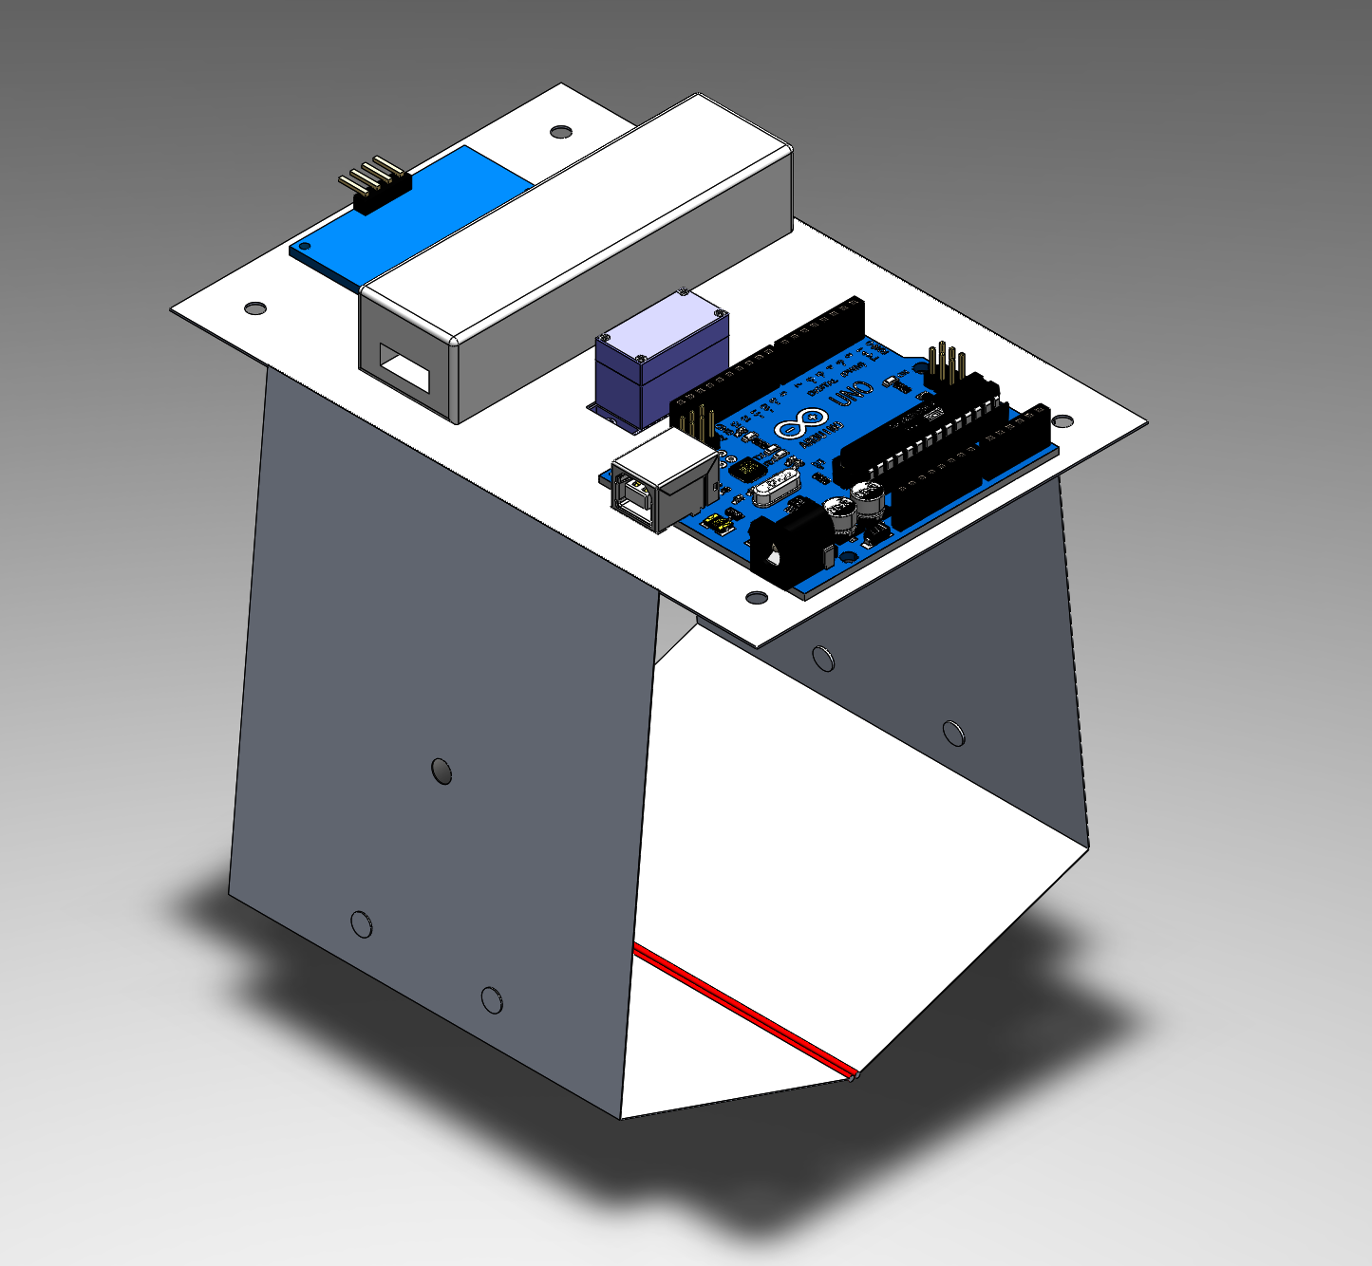
S.M.A.R.T Claw
Team T7

Slide 2
Project Introduction
Introduction
01

Slide 3
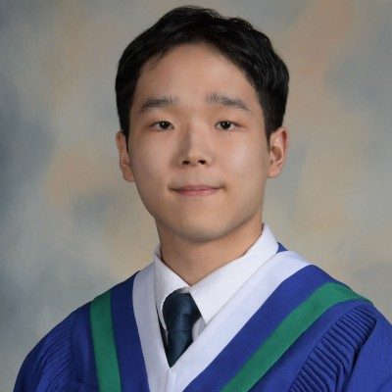
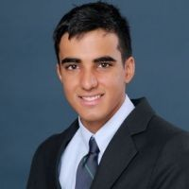
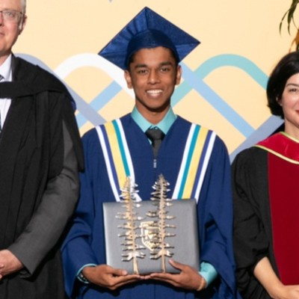


Meet the T7 Team
Christian Lee
Lead Designer
Rohin Dhaliwal
Prototypes & Experiments Lead
Shaiv Ramdhani
Programming Lead
Om Chaudhari
CAD & Drawings Lead
Tony Tang
Claw Manufacturing Lead
Notes:
christian

Slide 4
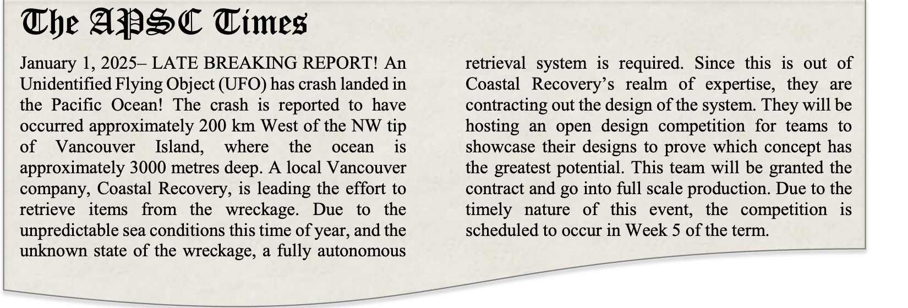
Design Challenge
Our goal is to design a fully autonomous retrieval system. The design should serve as a small-scale prototype of a device to be used in retrieving the UFO from the Pacific Ocean.

Slide 5
Design Specifications
A list of requirements and evaluation criteria influenced by the competition rules
Requirements
R1 | Device must use NO MORE THAN ONE of each of (1) Arduino board, (2) servo motor, and (3) ultrasonic sonar
R2 | Device must be able to pick up and release an object autonomously; only raising and lowering can be controlled by a human operator
R3 | The device must only be constructed from materials listed in Table 1 of the Module 5 rules document
R4 | The device must be able to deposit objects into a 8ft x 8ft box with a height of 2in
Evaluation Criteria
C1 | The greater the number of Round 1 objects that the device can retrieve, the better
C2 | The greater the number of 1.25in cubes the claw device can simultaneously retrieve, the better
C3 | The smaller the delay between detecting the object and retrieving / releasing it, the better
C4 | The lesser the degree of unwanted swinging or rotating when attached to the crane, the better
C5 | The lower the number of moving parts (and hence the lower the risk of mechanical failure), the better
Notes:
Rohin

Slide 6
Extensive Prototyping
Code
Optimization
Risk
Management
Design Strategy
Prototype as many feasible designs as possible
Experiment and prototype using rapid construction materials
Approach code design with the same degree of rigour as the retrieval device
Code should minimize wasted time and accurately retrieve objects
Use risk identification and registers throughout our project
Minimize risks through experiments
Notes:
Chris and Rohin

Slide 7
Project Introduction
Concept Generation
02

Slide 8
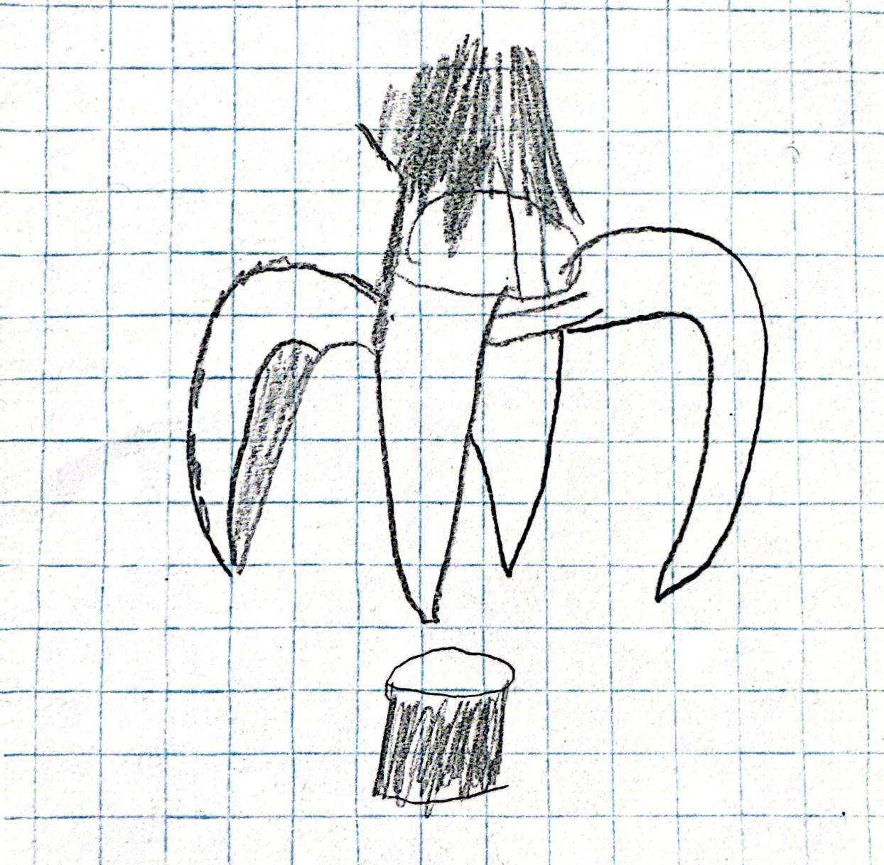
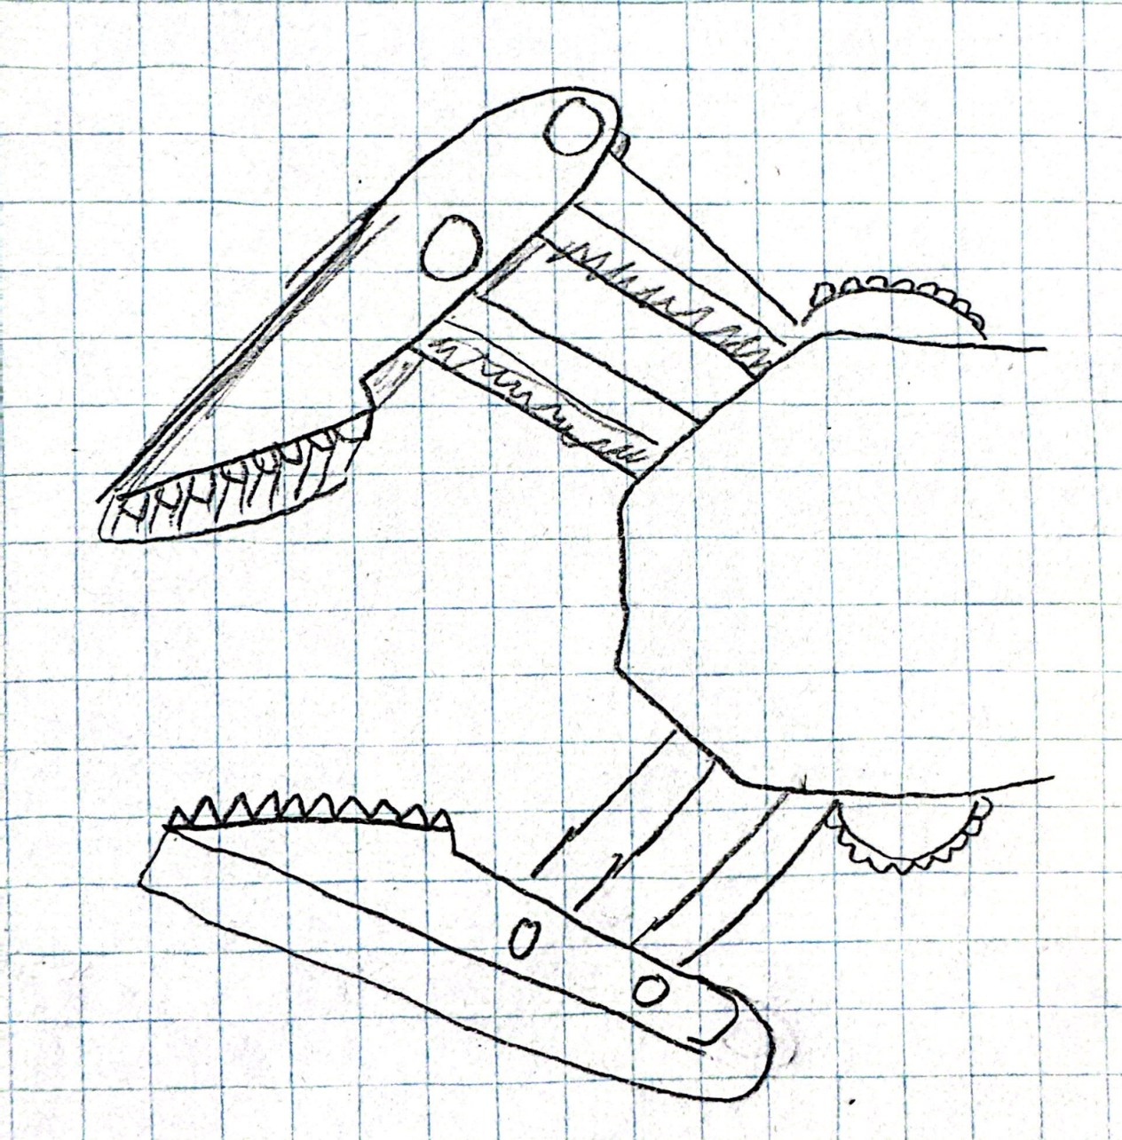
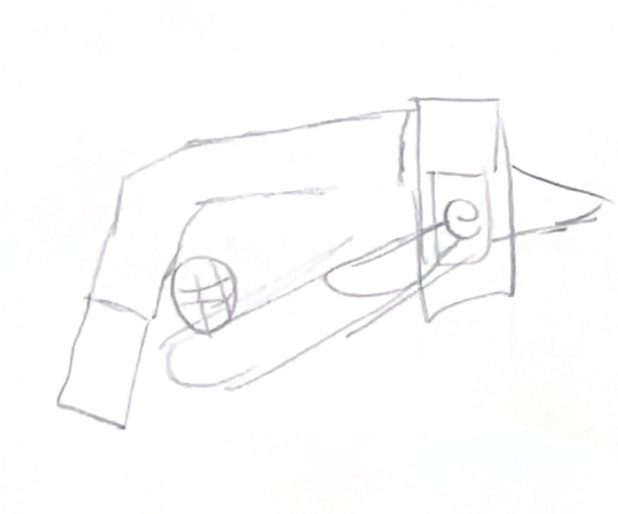
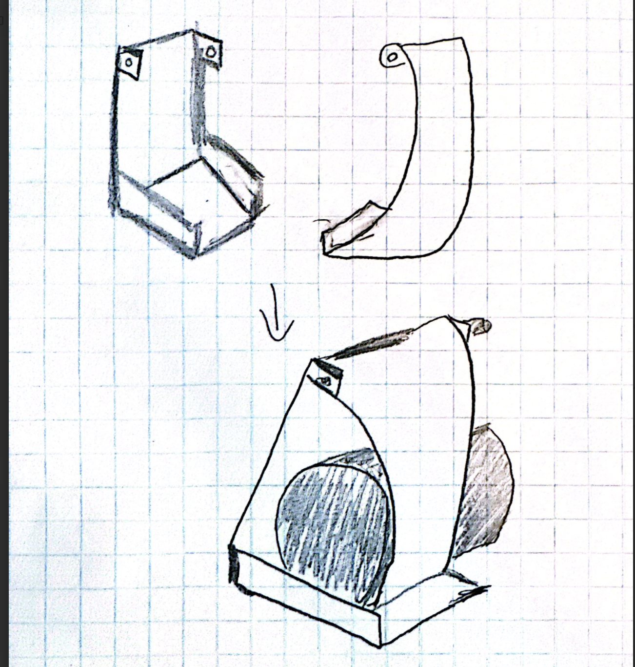
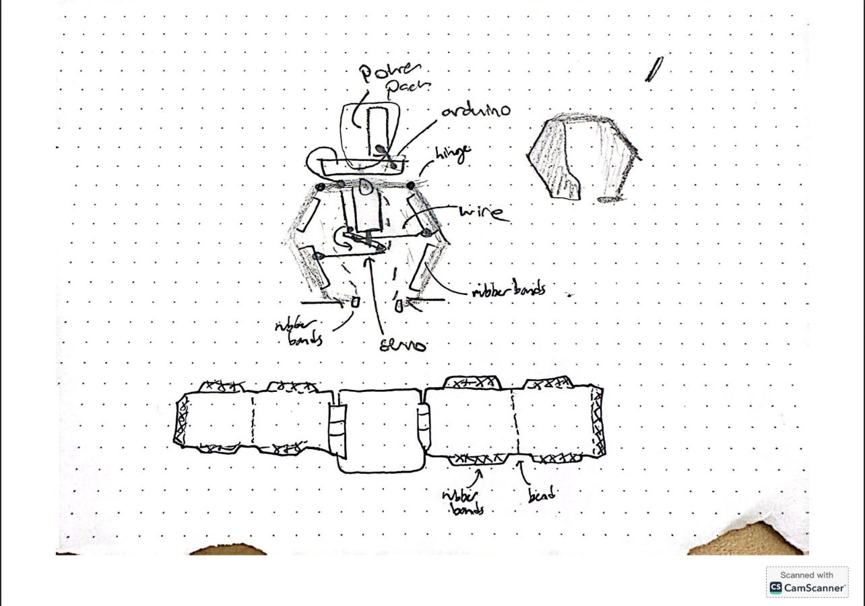
Initial C-Sketches
Half Octopus - C.L.
The Crab - R.D.
The Trapper - O.C.
Scooper - T.T.
Engulfer - S.R.
Notes:
Rohin

Slide 9
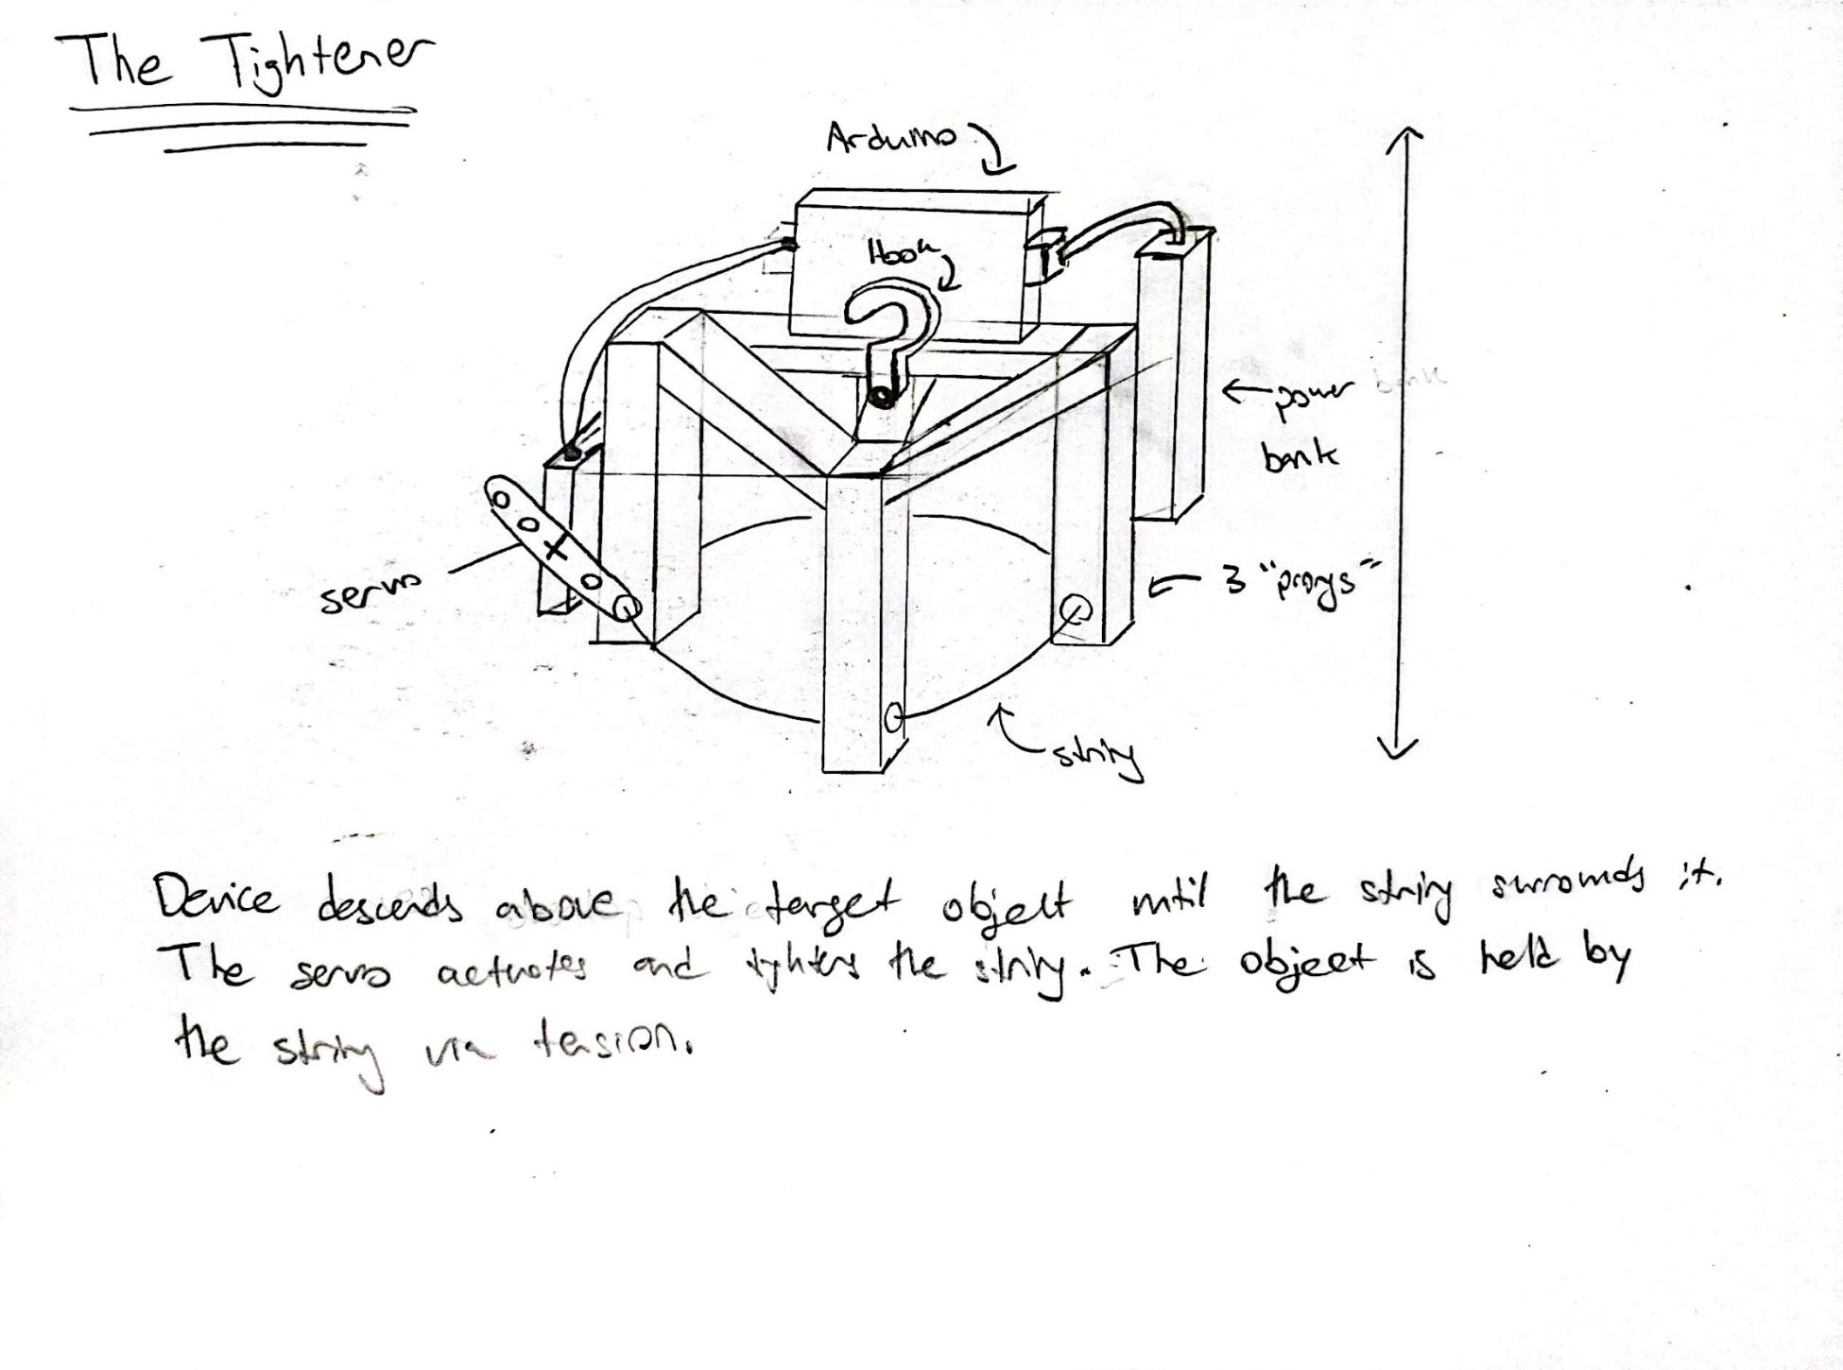
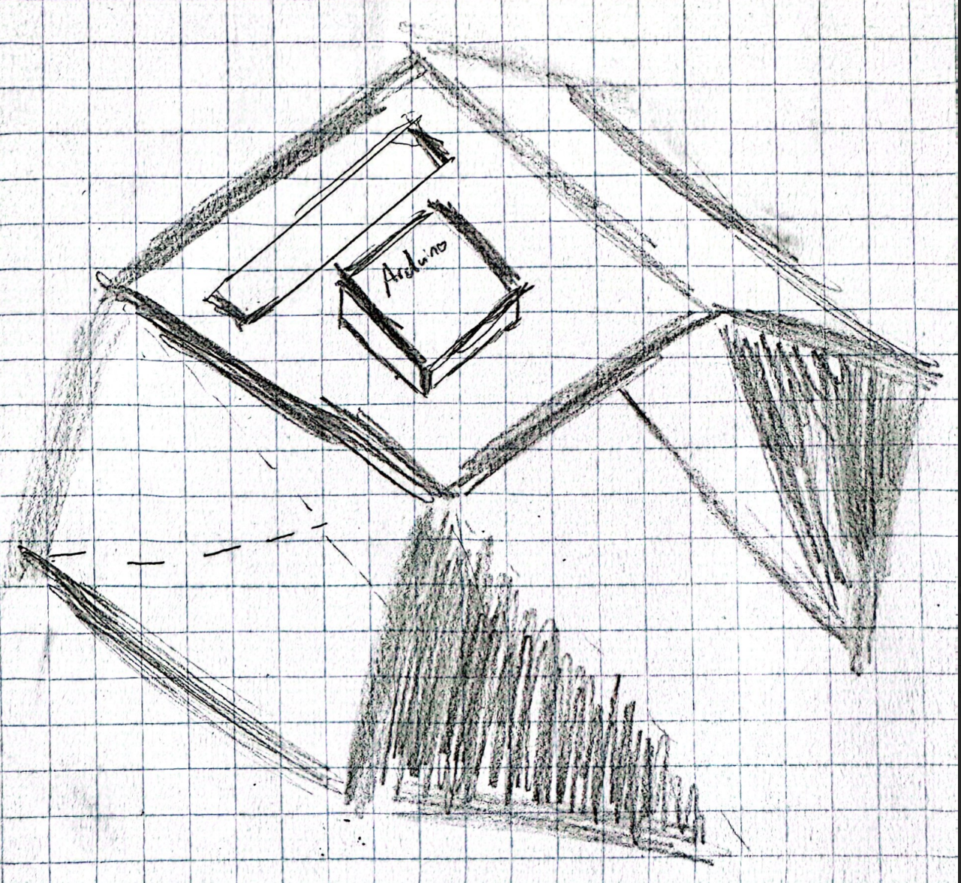
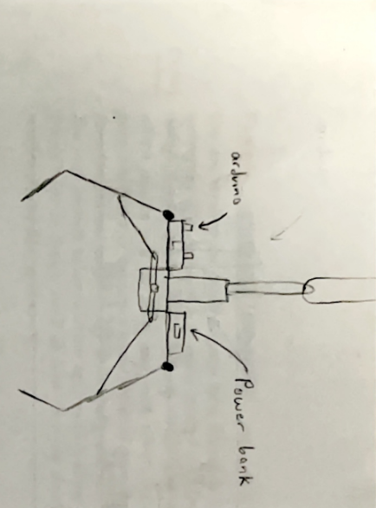
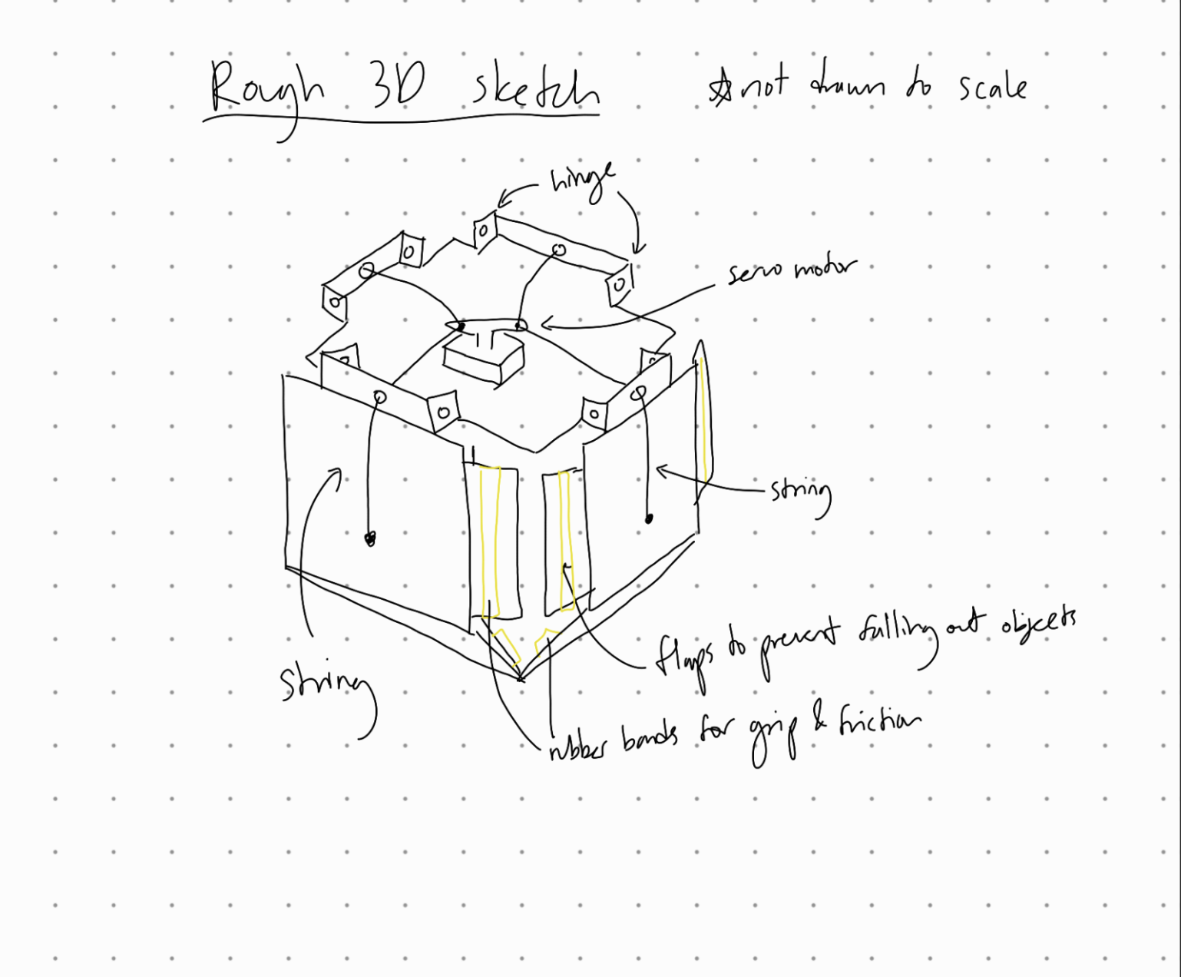
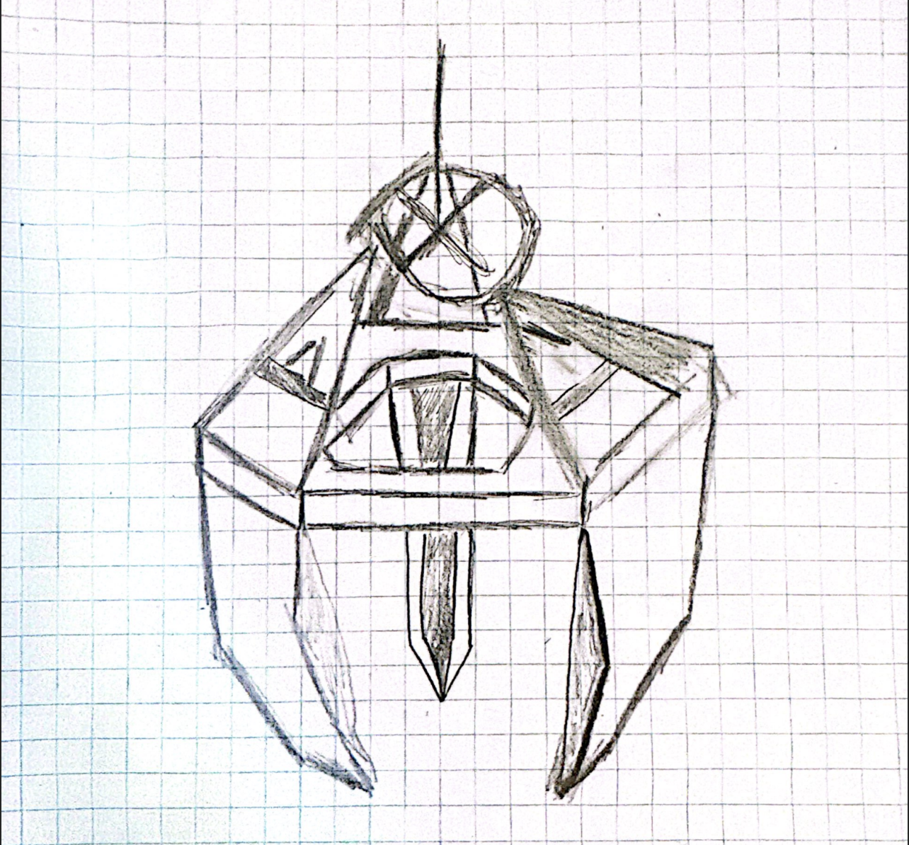
Individual Sketches
The Tightener - R.D.
The Trapper - S.R
The CAGE claw - C.L.
The Excavator - O.C
Three-Way Split- T.T
Notes:
Rohin

Slide 10
Prototypes & Concept Evaluation
Prototypes & Concept
Evaluation
03

Slide 11
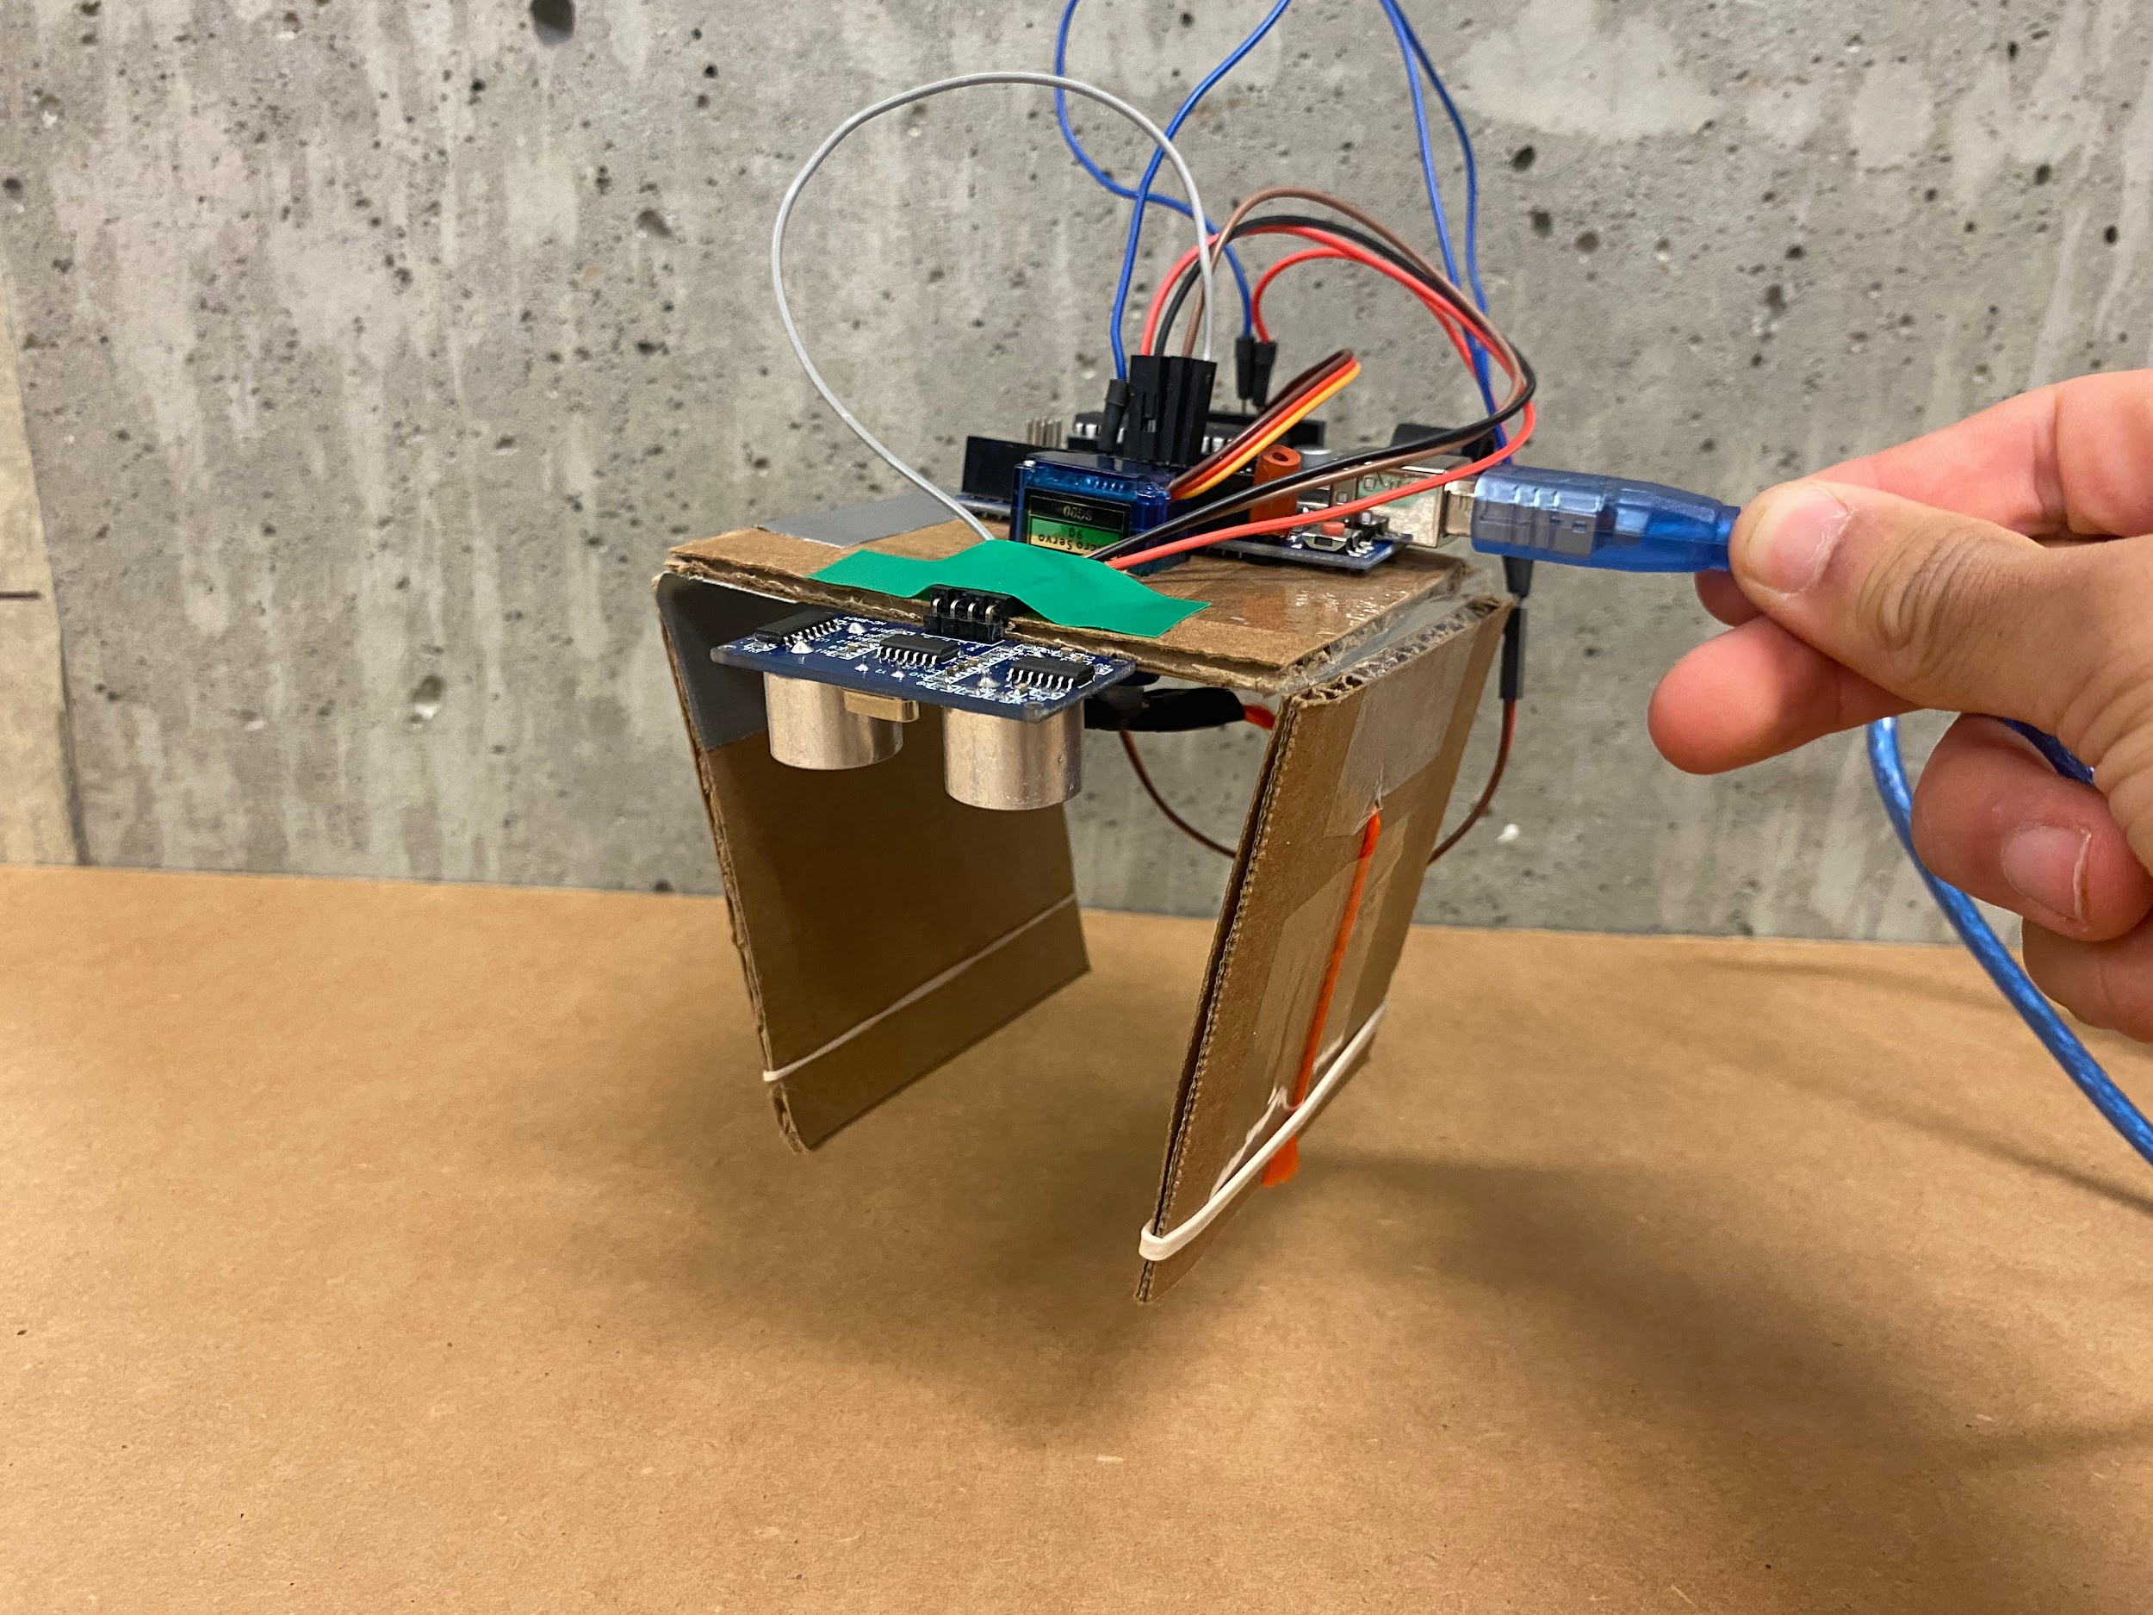
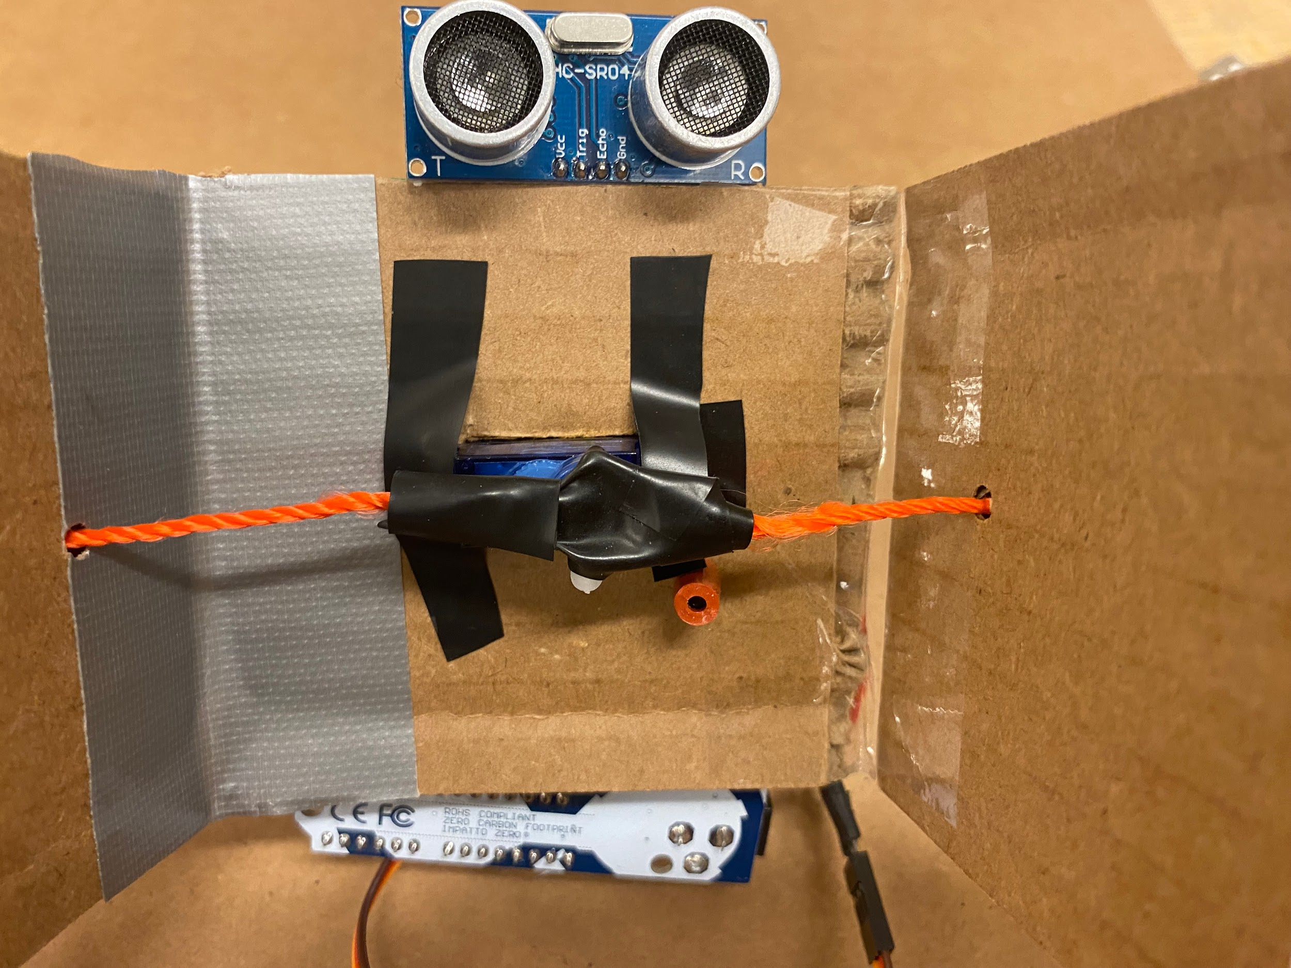
First Prototype – “Trapper” Concept
Strengths: easy to build; strings provide enough force to lift a pencil case
Weaknesses: limited range of motion; claw relies solely on friction to lift objects
Notes:
Rohin

Slide 12
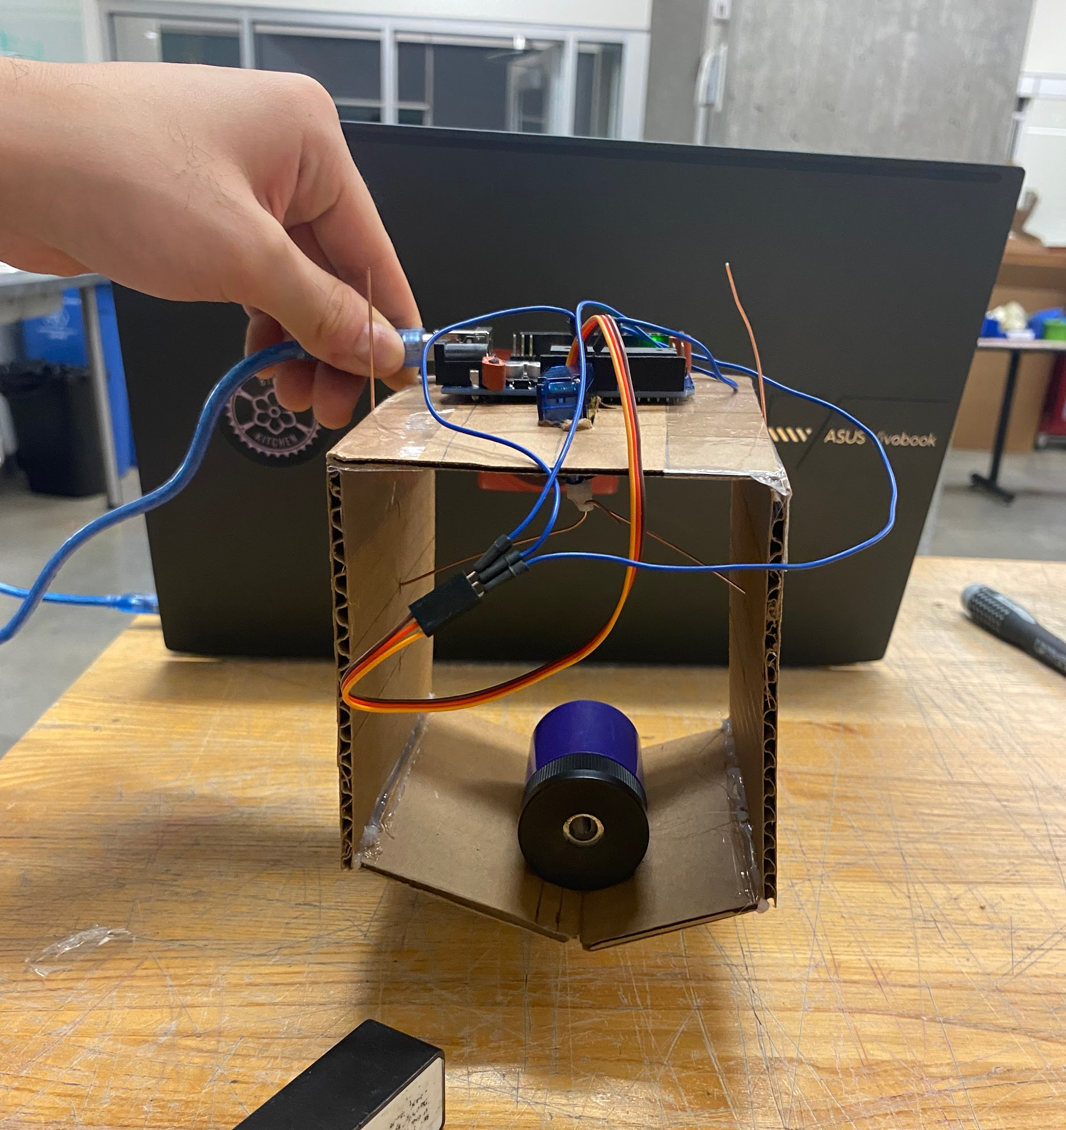
Second Prototype – Adding Angled Tips
Strengths:
Can pick up heavy objects (e.g. stapler)
Replacement of string with rigid wire increased range of motion of claw (wires can both pull and push the claw arms)
Weaknesses:
Round objects may slide out of the sides of the claw arms
Cardboard connected with hot glue is structurally weak
Angled Tips
Notes:
Rohin

Slide 13
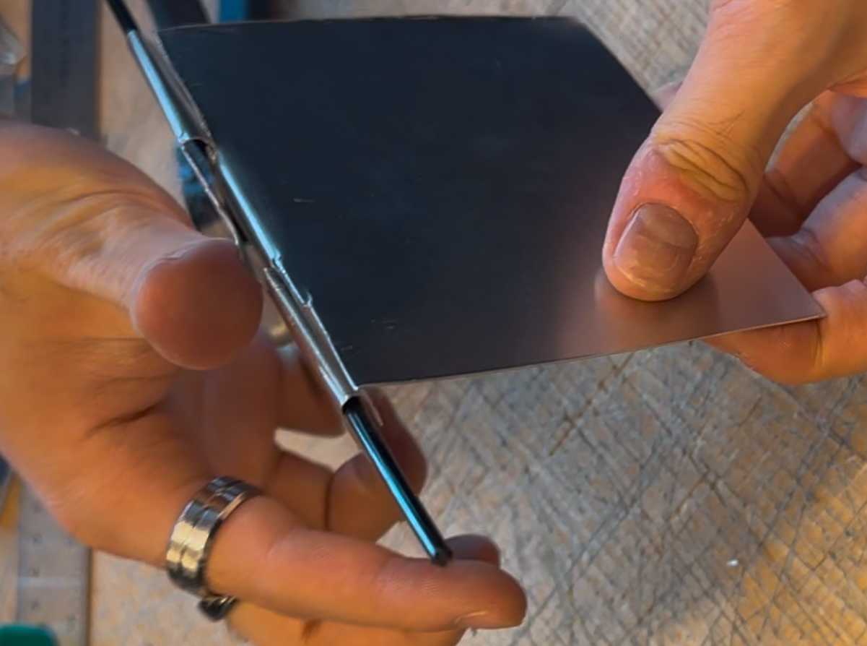
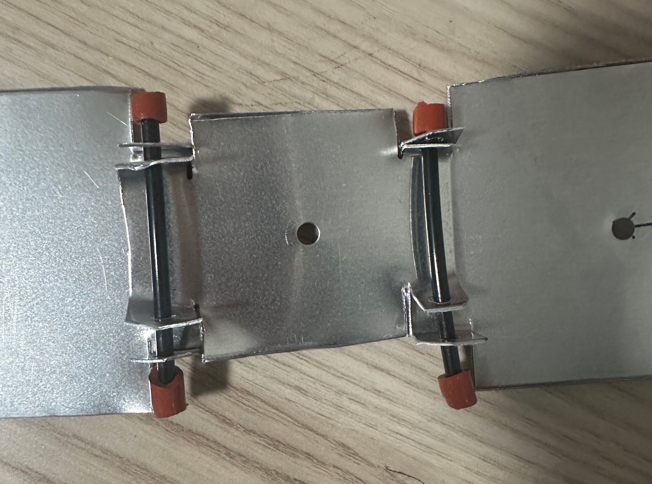
Prototyping Hinge Mechanisms
Tape Hinge
Strengths:
Easy to construct
Quickly Adjustable
Weaknesses:
Lower strength (but enough to hold Round 1 & 2 objects)
Slightly flimsy
Rank - 1 (Chosen Design)
Side Hinge
Strengths:
Smooth rotation
Full range of motion
Weaknesses:
Construction time is lengthy
Difficult to align claw arms precisely
Rank - 2
Three Section Hinge
Strengths:
Highest durability
Precise alignment of arms
Weaknesses:
Assembly of panels is difficult
Additional friction increases force required by servo motor
Rank - 3
Notes:
Shaiv

Slide 14
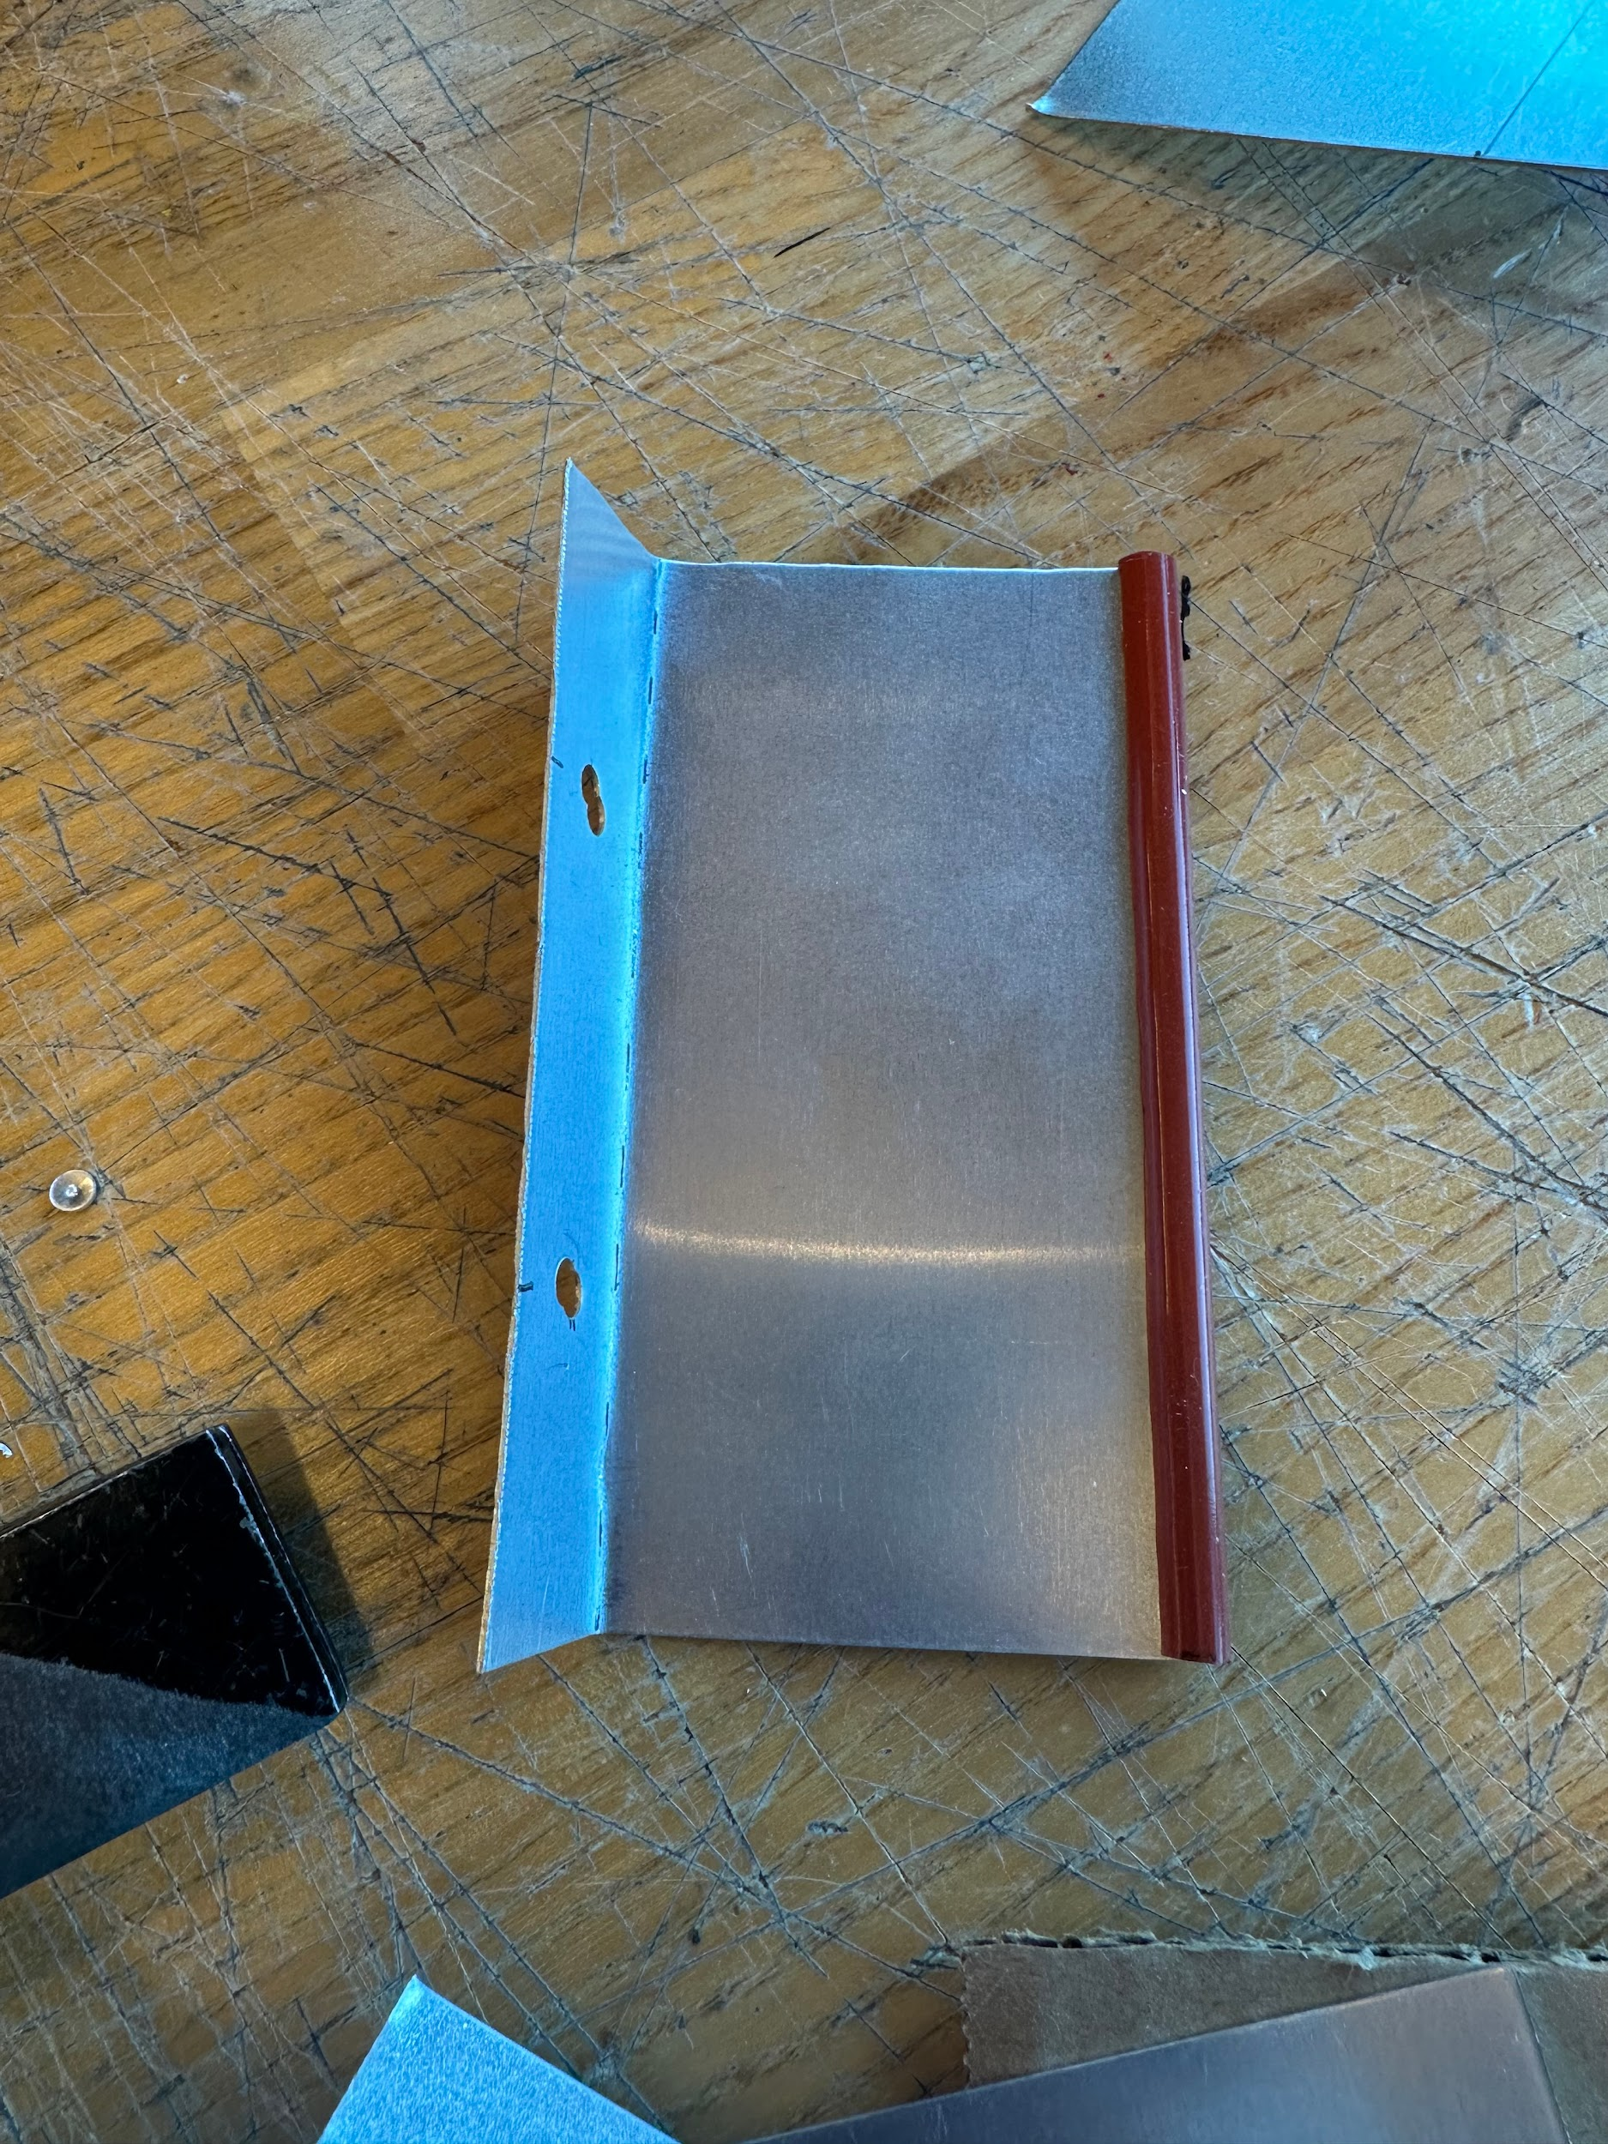
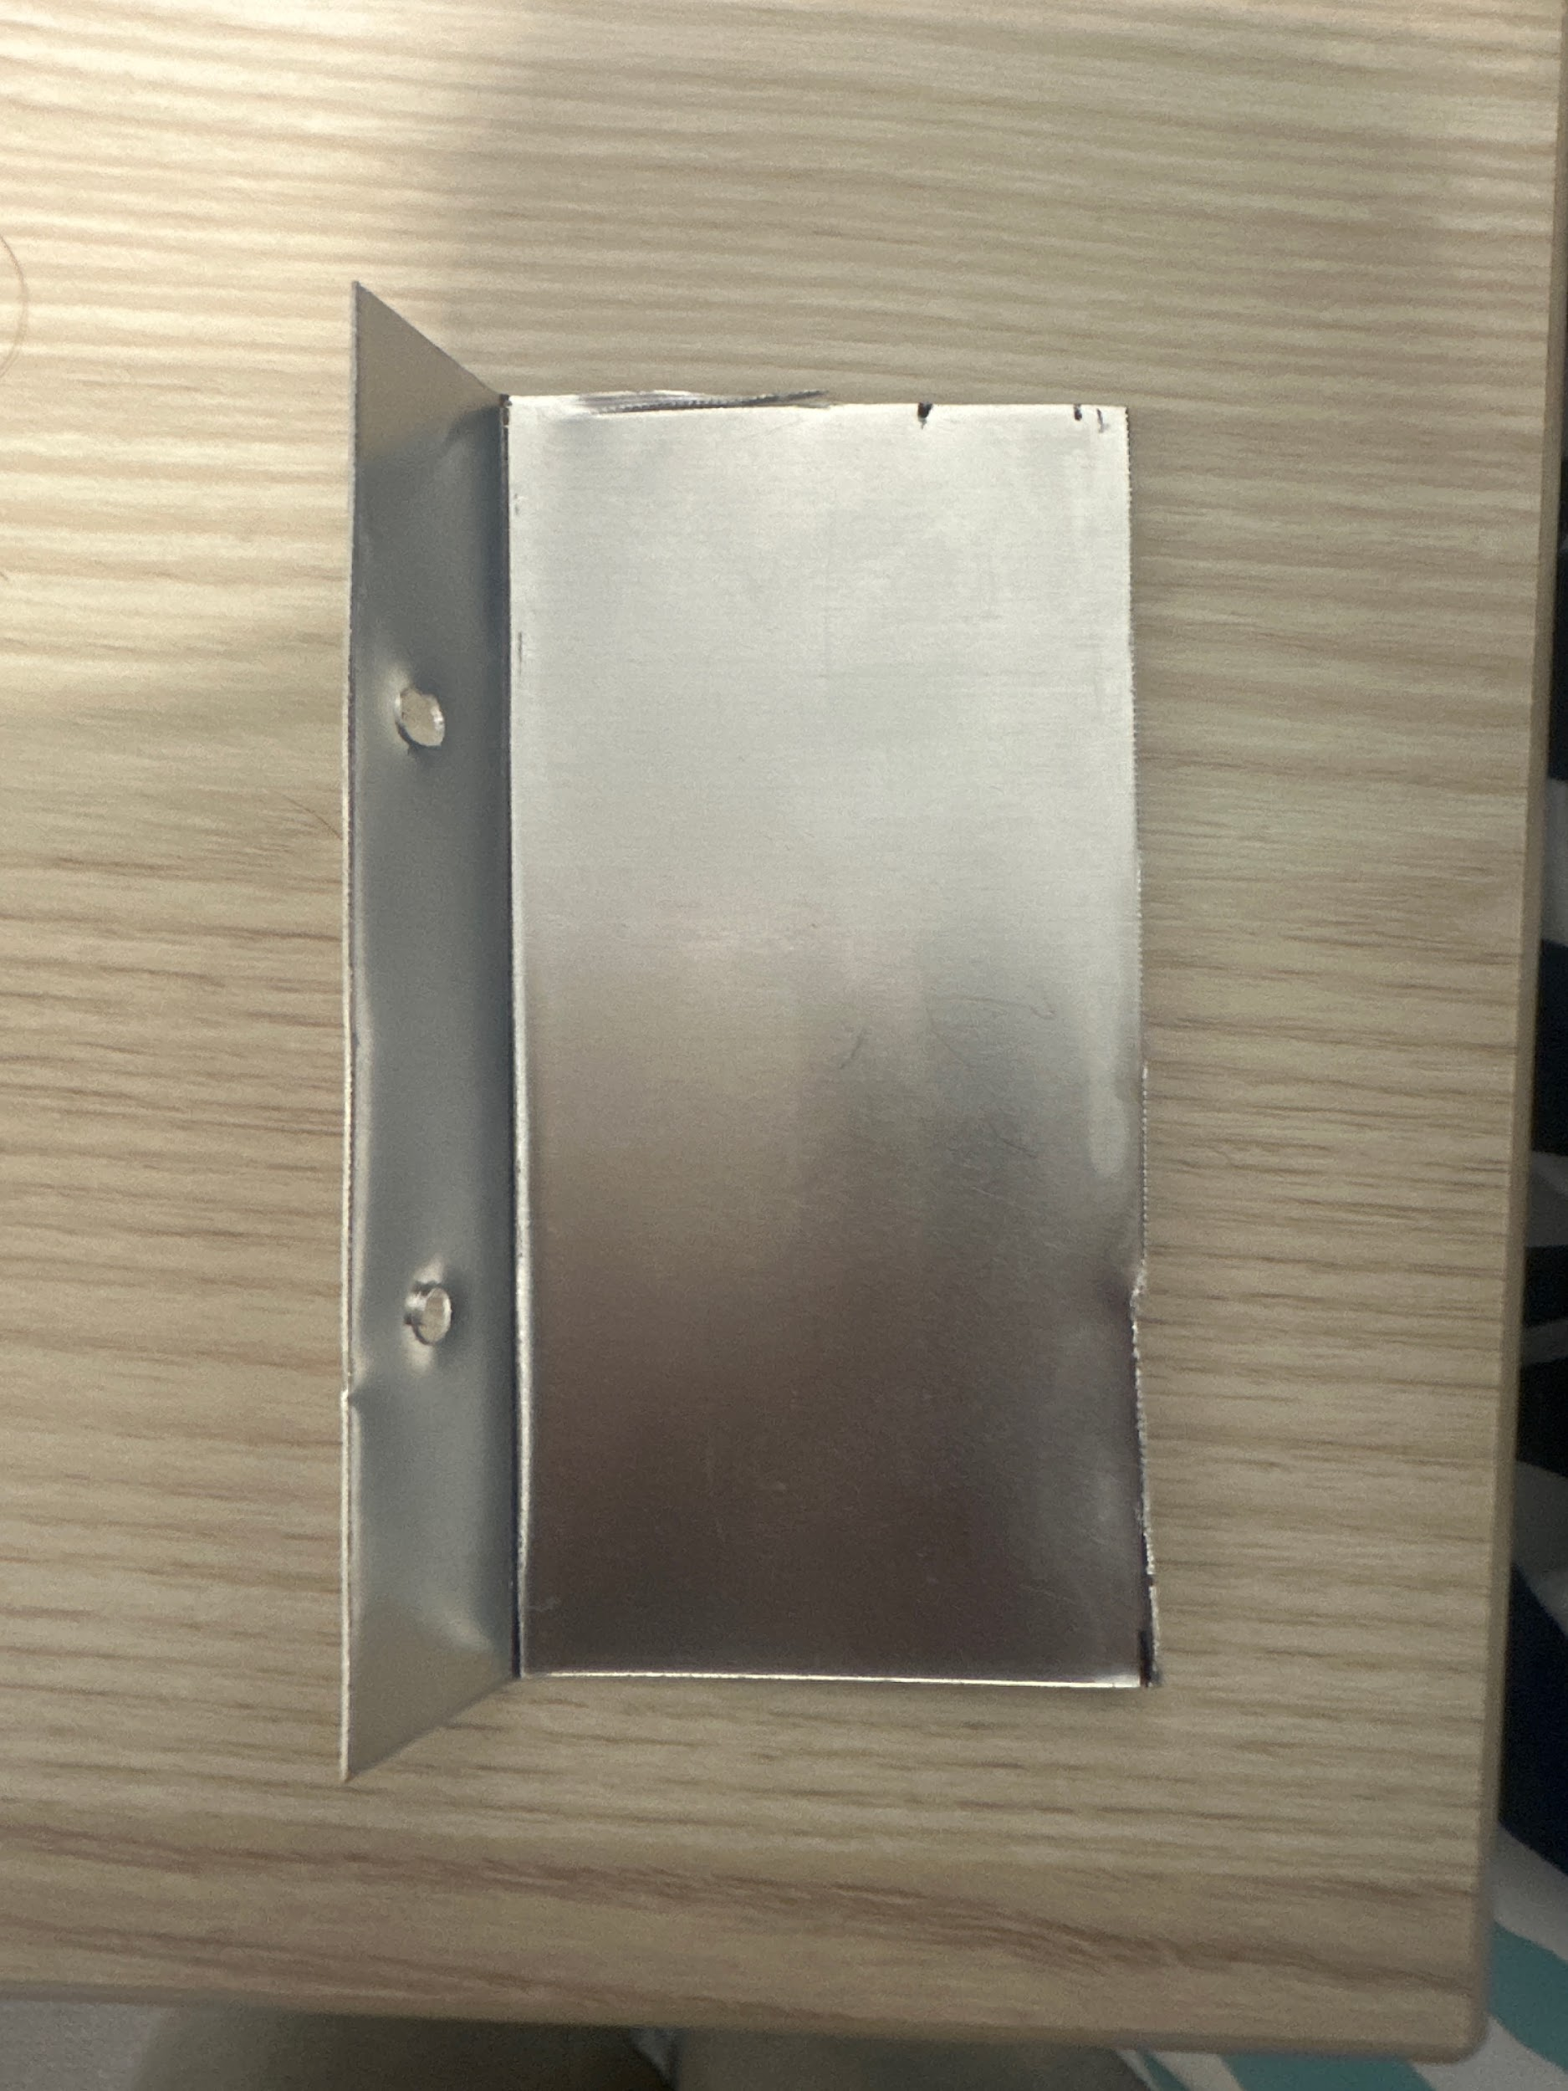
Testing Use of Rubber Lining
With Rubber
Strengths:
Stronger grip on objects
Less force required from servo
Weaknesses:
Can disrupt alignment of claw arms
Can get caught on the ground
Conclusion: Ideal for Round 1
Increased friction improves chances of retrieving a wide variety of objects
Without Rubber
Strengths:
Can scoop objects by smoothly sliding against the ground
Weaknesses:
Cannot hold heavier objects with low coefficients of friction
More force needed from servo
Conclusion: Ideal for Round 2
Aluminum edges can scoop along the floor and retrieve multiple objects
Notes:
Shaiv

Slide 15
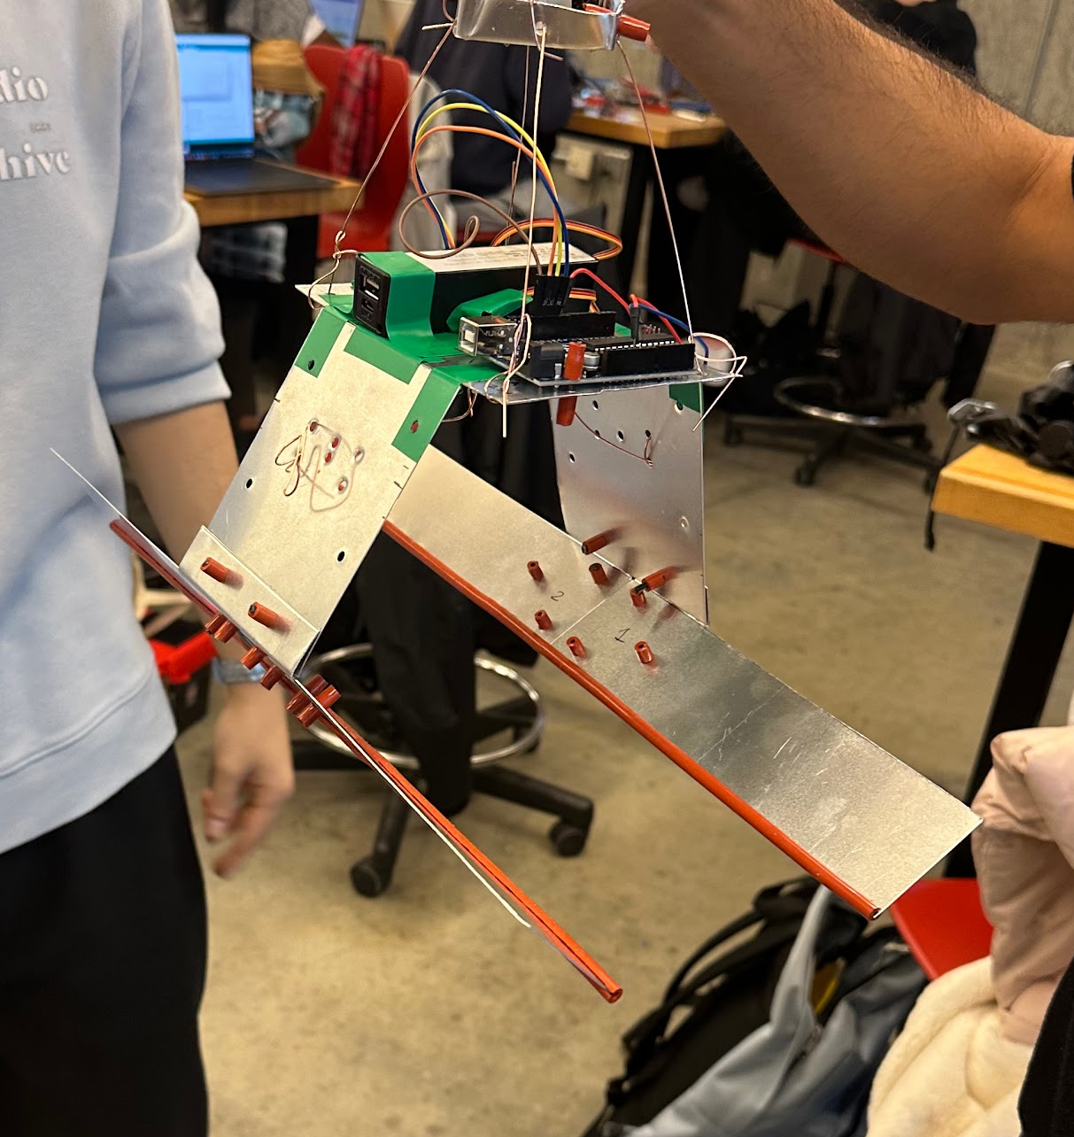
Testing Round 2 Specialized Claw
Test Notes:
We tested a larger claw arm tailored for bulk objects Round 2
The imprecise cuts in the metal prevent an equal force distribution, causing a few cubes to slip out of the claw arm
Our solution was using popsicle sticks to extend the claw
Larger Claw Arm Attachments
Notes:
Shaiv

Slide 16
Prototypes & Concept Evaluation
Risks, Experiments
& Concept Selection
04

Slide 17
Risk Register
Risk | Classification | Rating | Risk Management Strategy
Servo motor does not produce enough force to pick up objects. | Technical Preventable | 6 | Design an experiment to test the ideal placement and attachment of wiring in order to maximize the force
Sonar sensor has issues and interrupts the flow of our code. | Technical Strategic | 12 | Implement debouncing mechanism in code to counter variance Trial sonars to find best functioning one Backup code functioning off a timer
Any mechanical or technical failure on the day of the competition. | Project Management Preventable | 5 | Find functioning components and fully charge batteries Don’t excessively test our components
Scarcity of aluminium may require the use of weaker cardboard. Cardboard components are flimsy impacting our claws performance. | Technical Strategic | 4 | Test to see high stress areas in our claw High stress areas can be made of aluminium Lower stress area can be made of cardboard
Rubber tubing attachments drag on floor and prevent full closure. | Technical Strategic | 8 | Test between having the tubing and not having it Use two attachments that can be swapped out depending on object

Slide 18
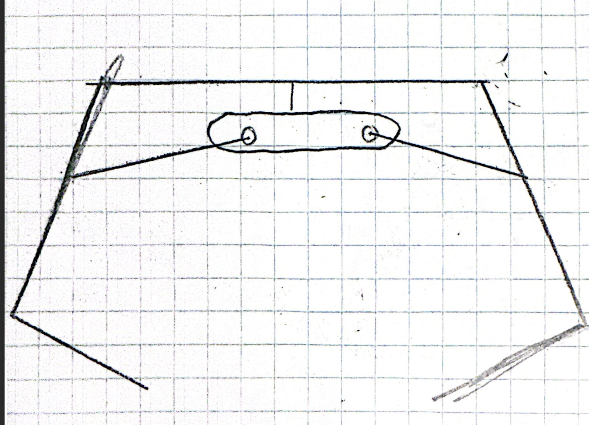
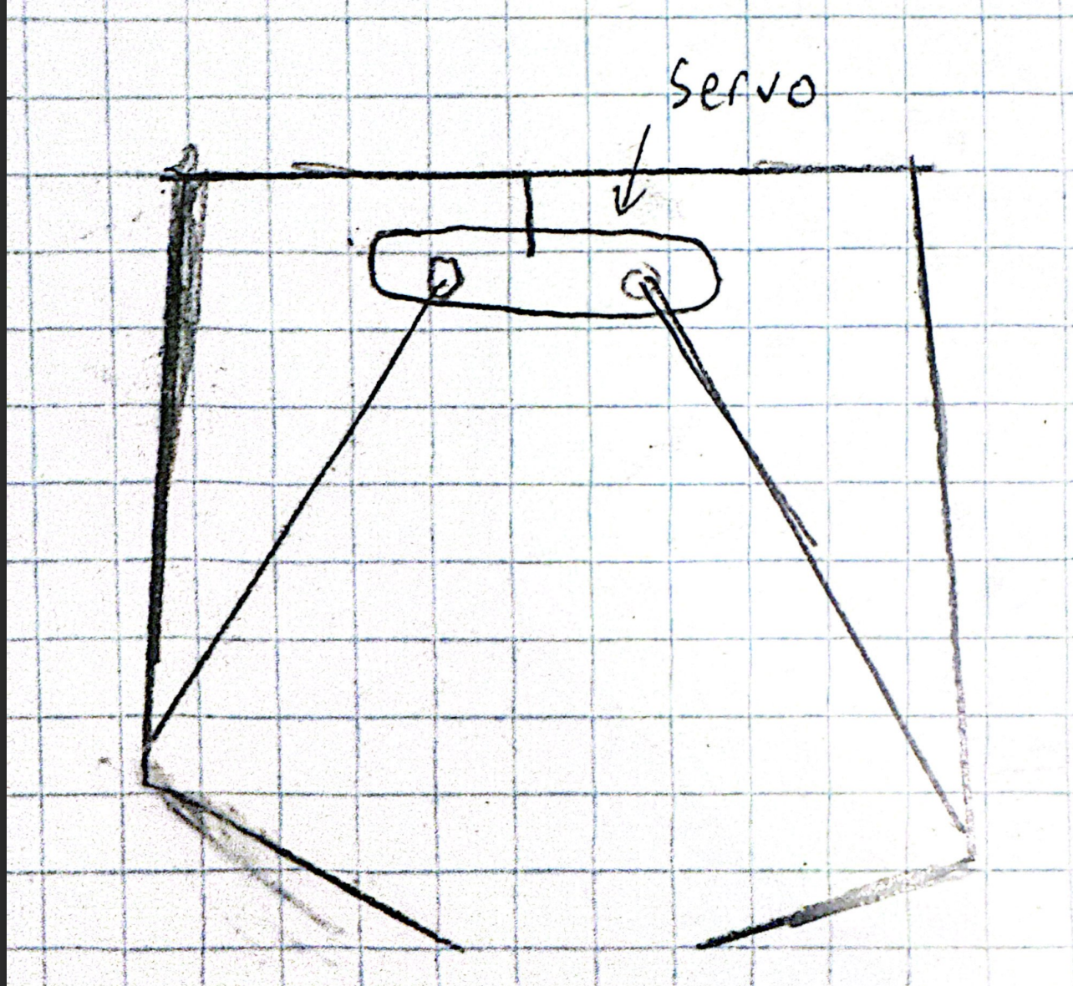
Risk Experiment 1: Wire Attachment Optimization
Research Question #1: What is the optimal positioning for the wires connecting the claw arms and the servo?
Research Question #2: How can we maximize the force without comprising the width of the claw?
Higher Wire Attachment
Less force translated through claw
Risk of lowering output force when retrieving objects
Larger claw width
Lower Wire Attachment
More force translated through claw
Smaller width of claw
Risk that jaw opening may not be wide enough to grab objects

Slide 19
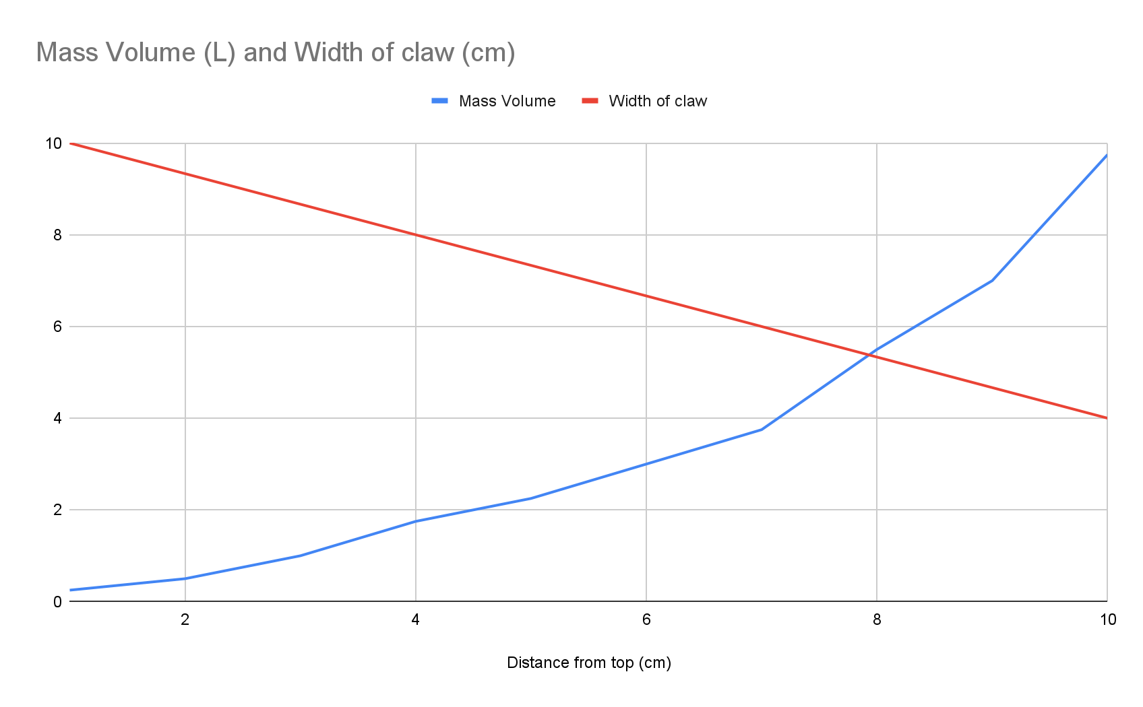
Risk Experiment 1: Wire Attachment Optimization
Experimental Setup & Procedure
Tested attaching the wires at distances 1-10 cm from the top of the claw
Measured the maximum amount of water in a water bottle held for each increment.
Measured the widest gap in between the two claw arms
Graphed scaled results
Volume of Water Lifted and Maximum Claw Width as Functions of Wire Position
Conclusion:
A wire position of 8 cm from the top yielded ideal results to mitigate risk.

Slide 20
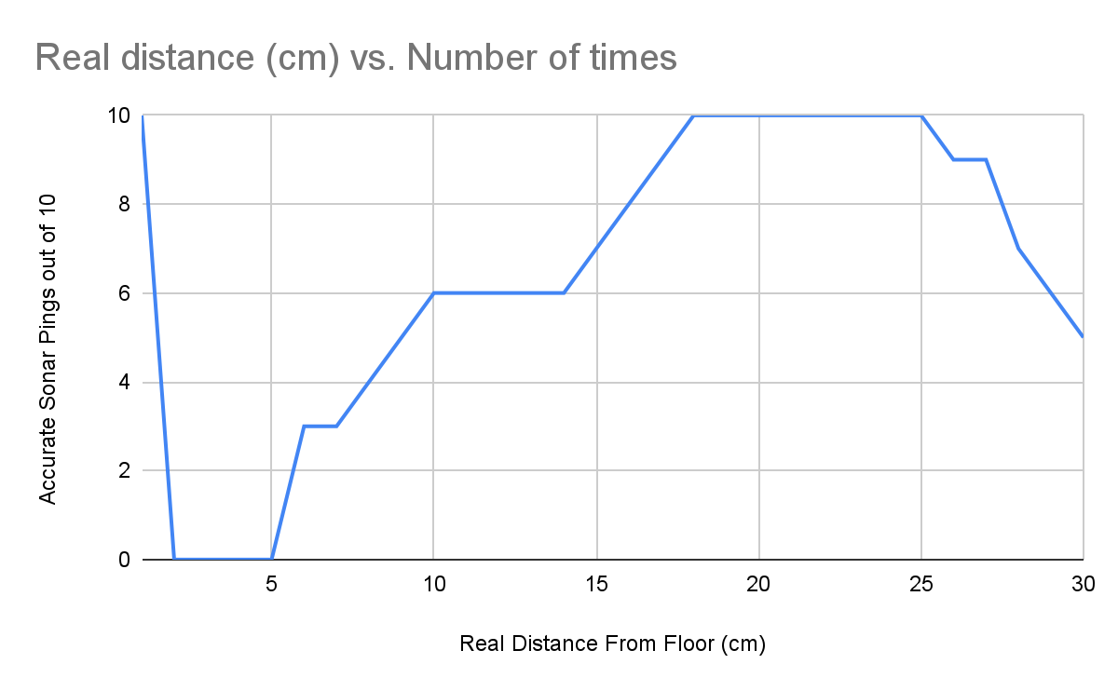
Risk Experiment 2: Sonar Reliability
Research Question: At what distance from the ground is the sonar most reliable?
Sonar Accuracy as a Function of Distance from Ground
Key Findings
Readings were compared to a ruler
0 cm was consistently accurate
Between 1 and 5 cm did not register anything
Peak accuracy between roughly 17-25 cm from the ground
This means our sonar should be set to trigger within this optimal range to avoid sonar malfunctions

Slide 21
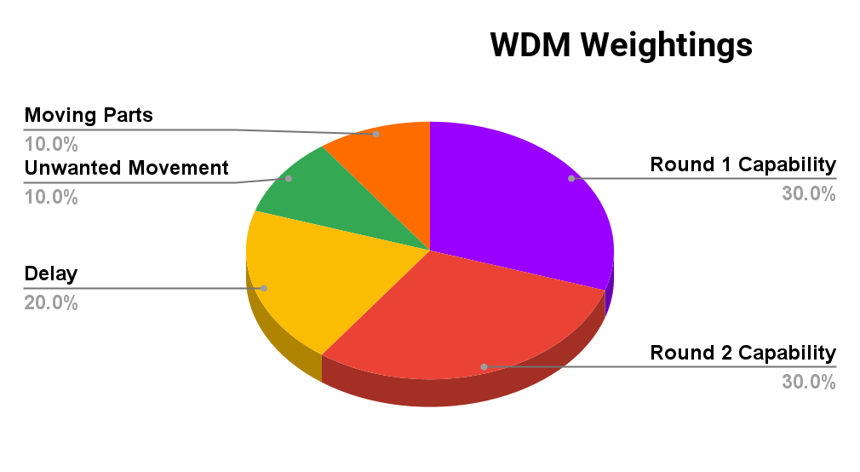
Weighted Decision Matrix
All 5 concepts passed screening
We elected to skip ranking due to a low number of concepts
We built our criteria based on our evaluation criteria and integrated Experiment 1 & 2 results in our evaluation
We distributed the criteria weights based on competition rules and team strategy

Slide 22
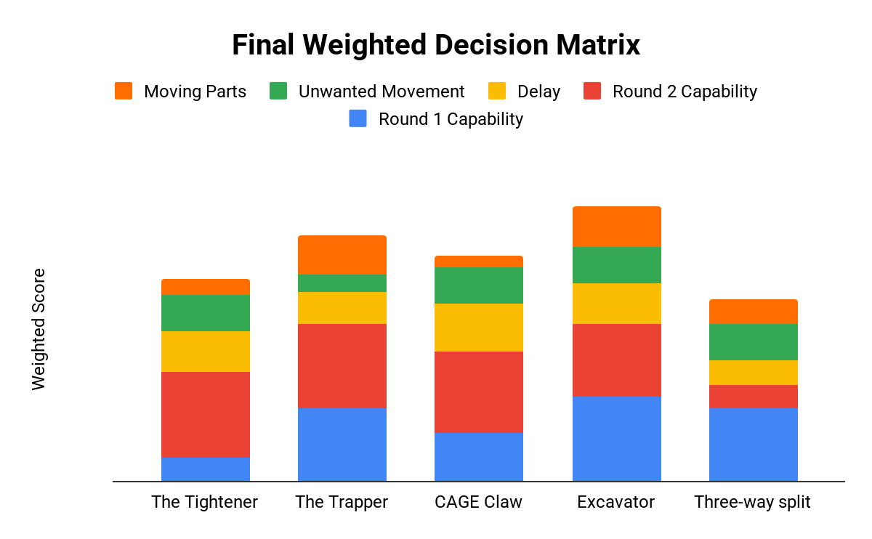
Weighted Decision Matrix
Final WDM resulted in The Excavator being the most promising concept.
Sensitivity analysis to ensure robustness:
Excavator remained our top concept
Minor changes across lower scoring concepts
Indicates our results are valid

Slide 23
Final Design
05

Slide 24
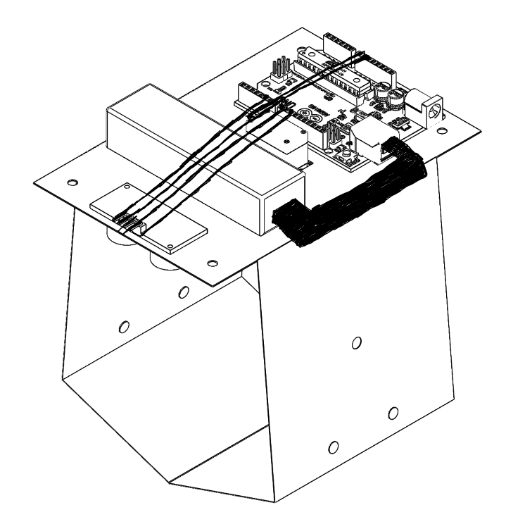
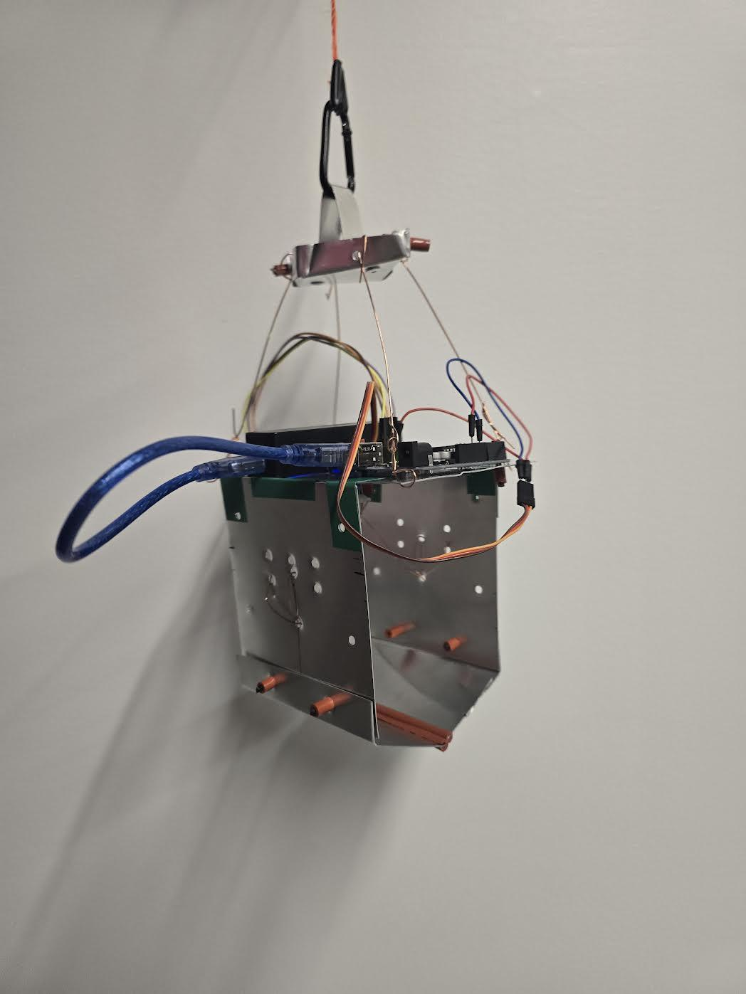
Final Design: The S.M.A.R.T Claw

Slide 25
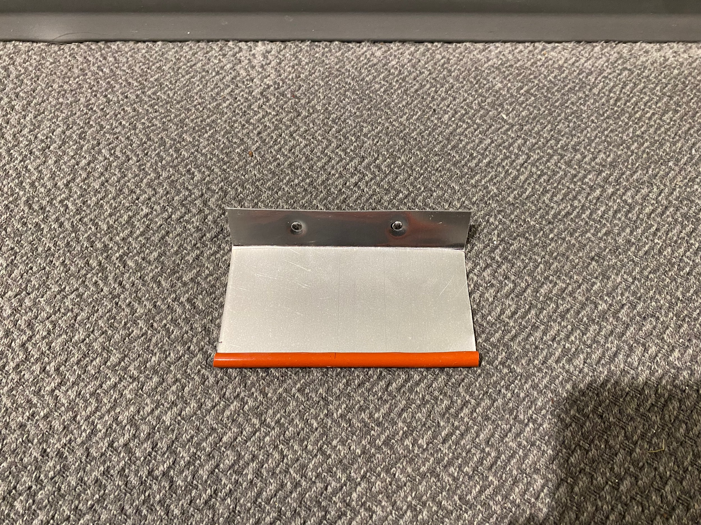
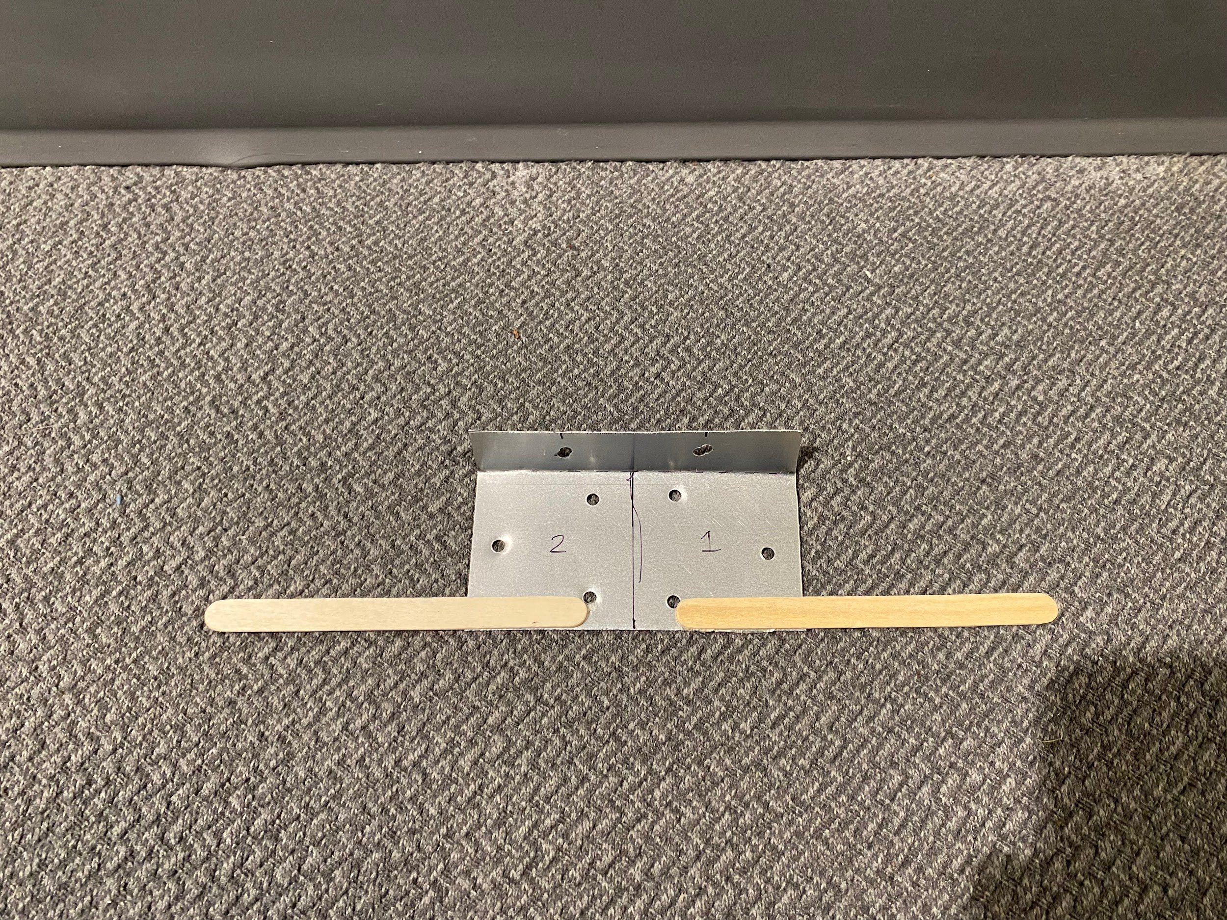
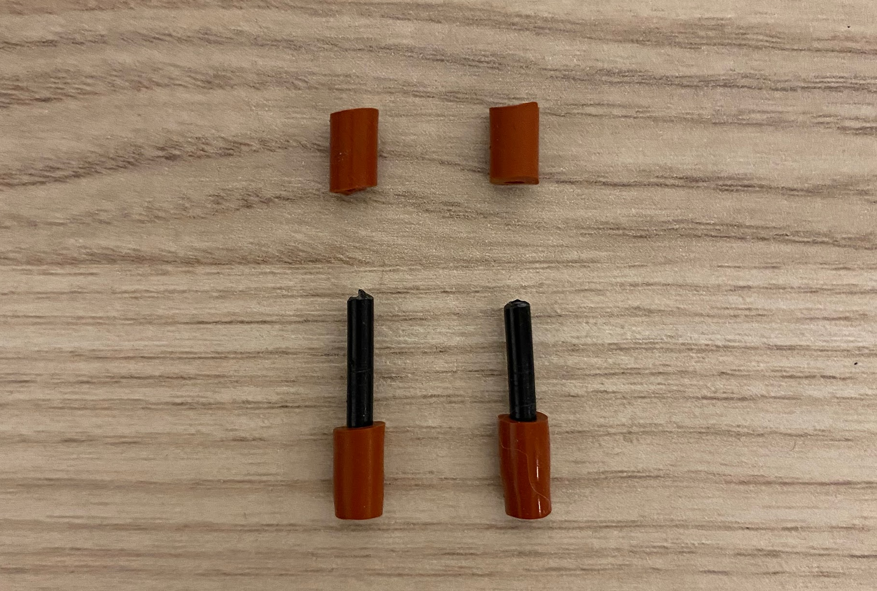
Modular Attachment 1
Modular Attachment 2
Pins
For Round 1 (Variety Objects)
Applies a focused force across a 4in span
Useful for heavier objects such as the can
For Round 2 (bulk objects)
Distributes force across 8in length for lifting multiple objects
Cubes are lightweight so we can pick up roughly 16 at once (8 x 2 grid)
Pins are made from red tubing and black rod
Pin system creates secure connections
Notes:
Rohin

Slide 26
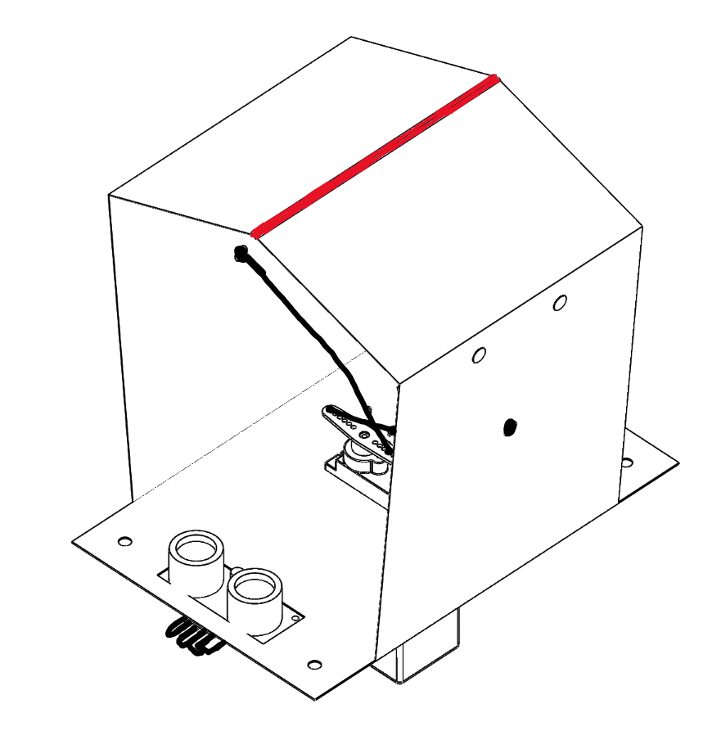
Final Design Features
Rubber Lined Edges
Rubber Lined Edges
Insertable red rubber lining on the edges of the claw, enhancing grip, handling, and friction between claw and object
Tape Hinges
Loosely attaches claw arms, minimizing the force required to open and close the arms while still providing a secure connection
Copper Wire Mechanism
The use of rigid wires efficiently generates force to open the claws wide, and sufficient force to firmly grab any Round 1 or 2 object without slipping

Slide 27
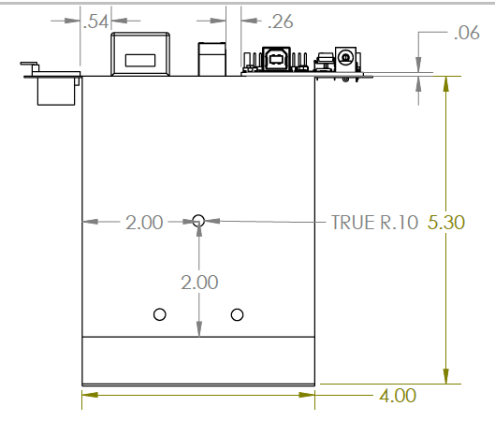
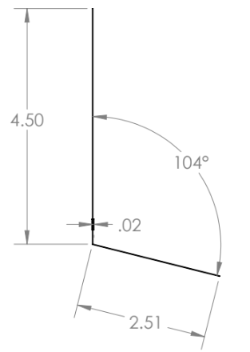
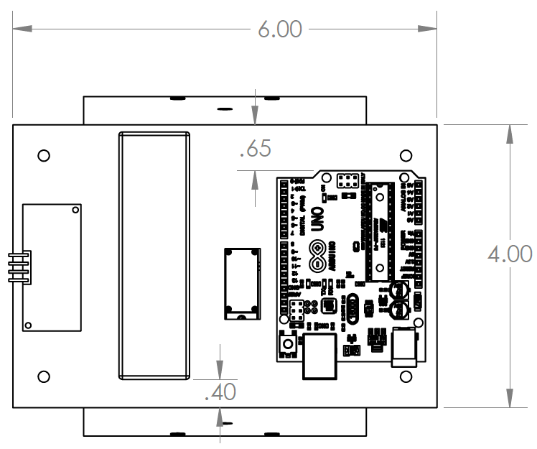
Final Design Dimensions
Analysis:
The 6x4 in² dimensions of the base ensure that the widest object in the competition can be fully enclosed inside of the boxed claw
The 4x5.3 in² dimensions of the claw ensure that the tallest object in the competition can be fully enclosed inside the claw
The claw edges make a 14° angle to the claw arm, which is suitable to retrieve an object while minimizing friction with the ground

Slide 28
Start
Close Claw
Final Design Code Flowchart
Distance < PICKUP_DIST for DEBOUNCE ?
Symbolic Constants:
PICKUP_DISTANCE = 25cm
OPEN_TIME = 3000ms
DELAY_TIME = 2000ms
DEBOUNCE = 500ms
Open Claw
Wait OPEN_TIME
Close Claw
Wait DELAY_TIME
Notes:
Rohin

Slide 29
Project Introduction
Reflection
06

Slide 30
Round 1
Reflection
Code functioned as intended
Sonar risk experiment results eliminated any sonar malfunctions
Challenges emerged in positioning of objects
Improvements
Develop a claw where spinning about the vertical axis is not as problematic
Improve claw width
In our risk experiment 1, we prioritized force over claw width
This decision may have been misguided as smaller claw width required more accuracy to pick up objects
Round 2
Reflection
Modular attachments enhanced pickup capability and overall performance
Enabled claw to pick up many cubes at once
Prototyped rubber lining maximized grip and reduced the force required per cube
Improvements
Uneven force distribution across claw arms caused cube instability when transporting to drop off zone
Competition Reflection

Slide 31
Om Chaudhari: Project Introduction & Risks
Rohin Dhaliwal: Prototypes & Concept Selection
Christian Lee: Concept Generation & Final Design
Shaiv Ramdhani: Experiments & Final Design
Tony Tang: Reflection
Team T7 did not utilize Generative AI in this project
Contributions

